Slide 1
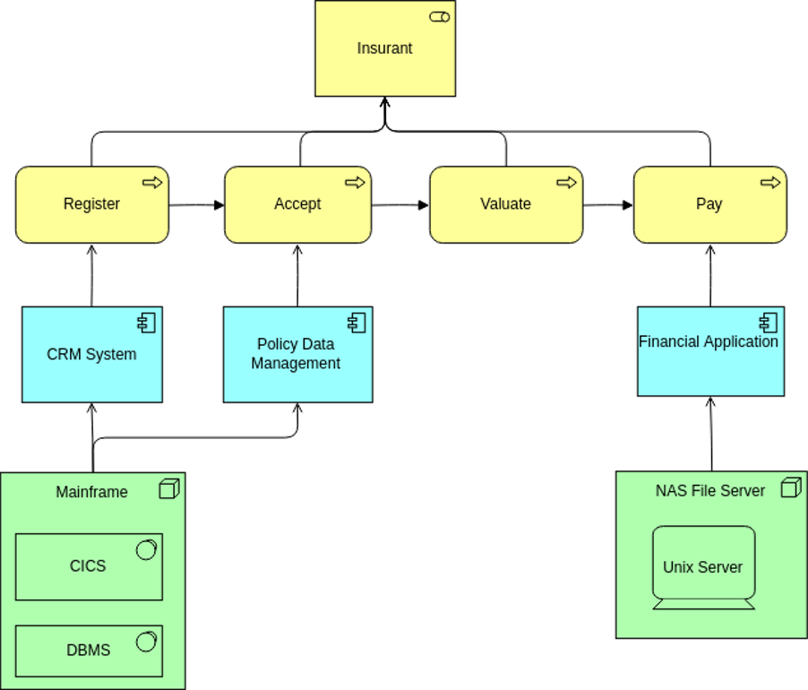


ArchiMate Cookbook in Action
Author: Eero Hosiaisluoma Instructor: Zhao Xiaoqi

Slide 2
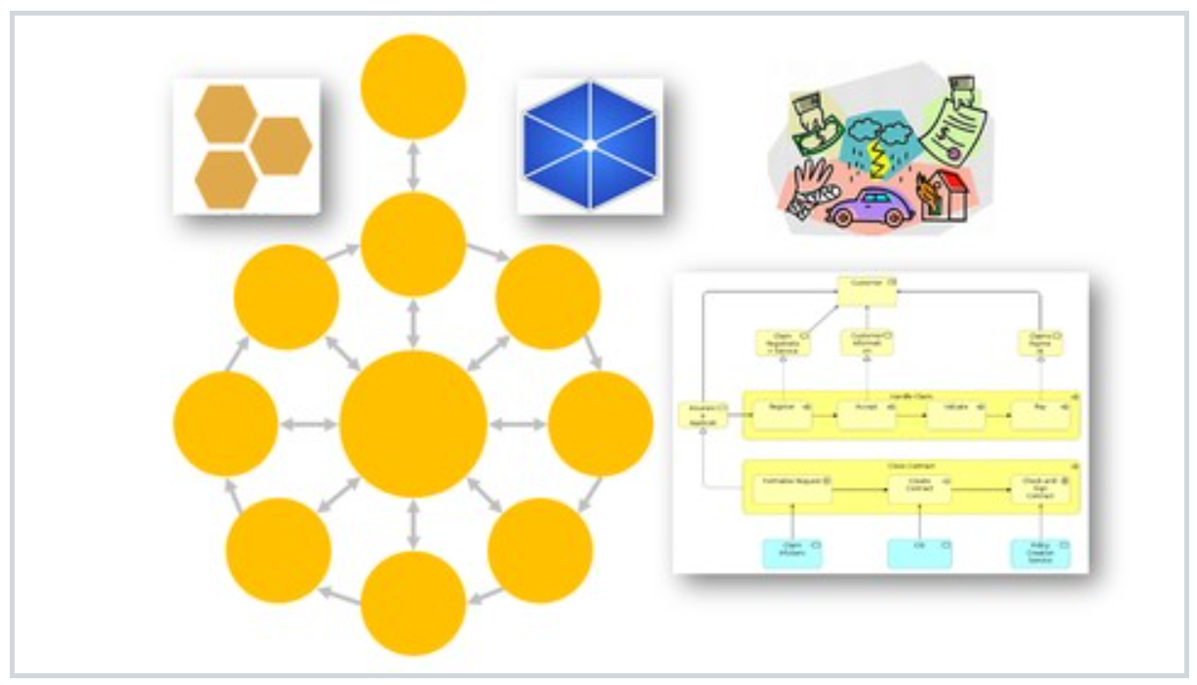
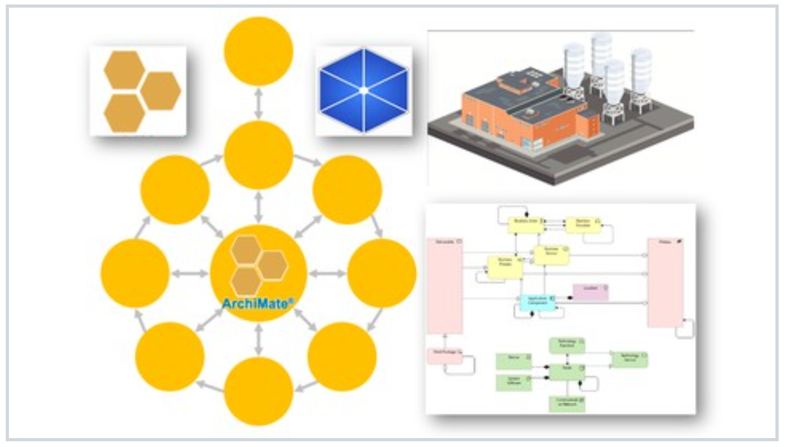
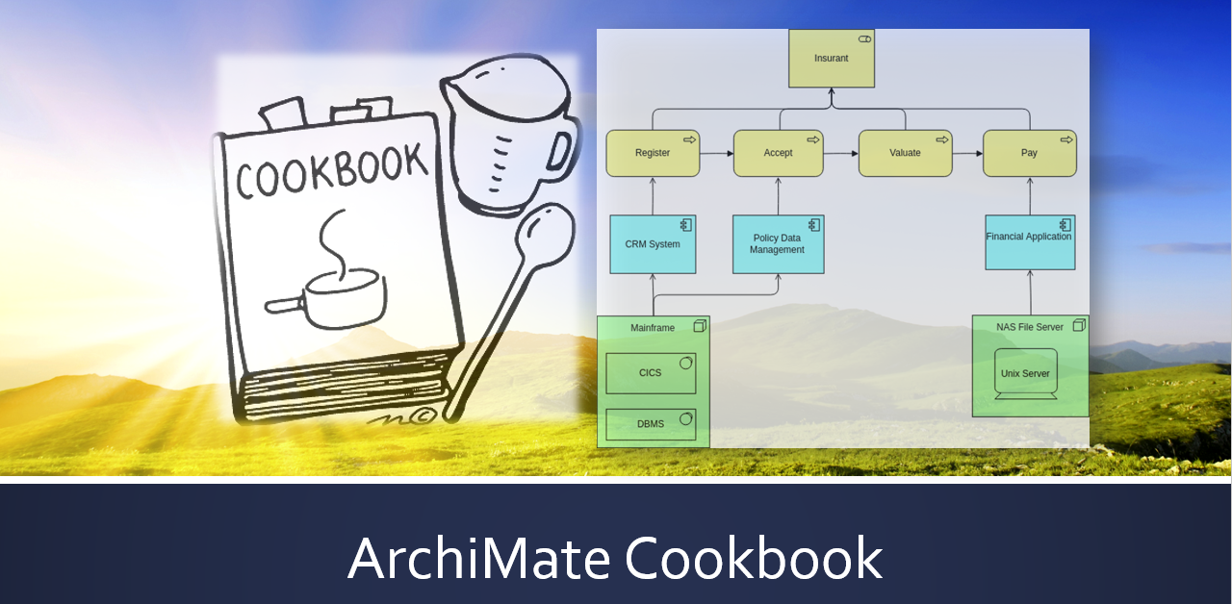
ArchiSurance
ArchiMetal
NEW

Slide 3
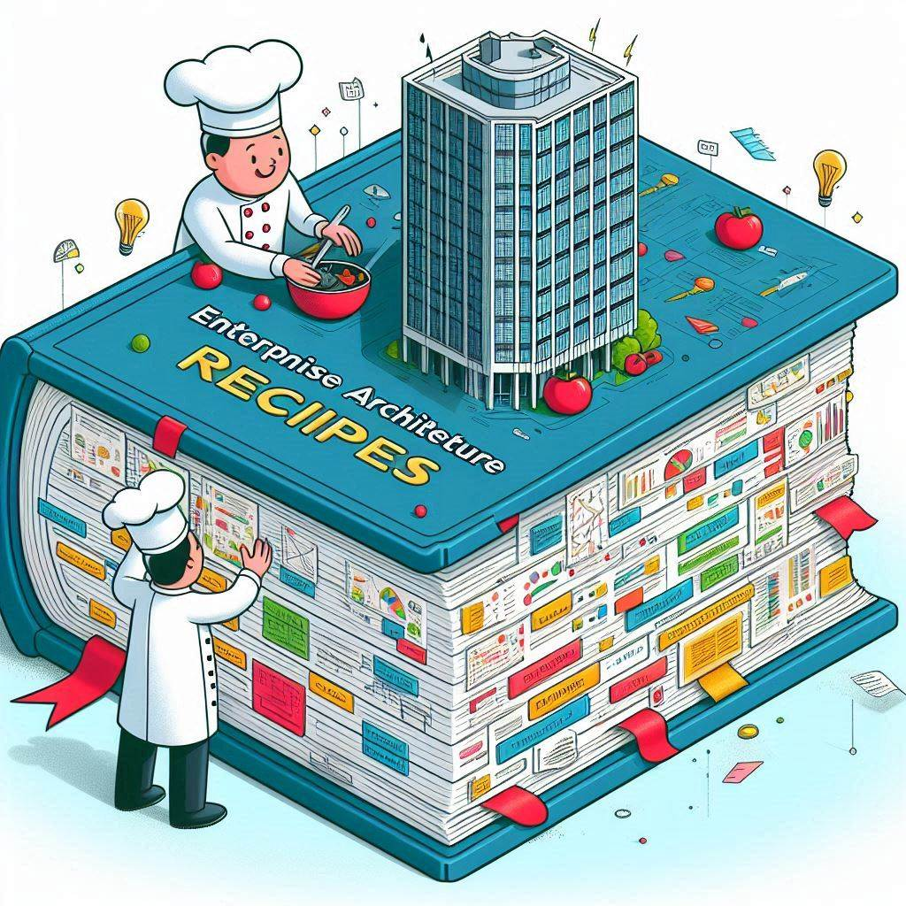


Slide 4

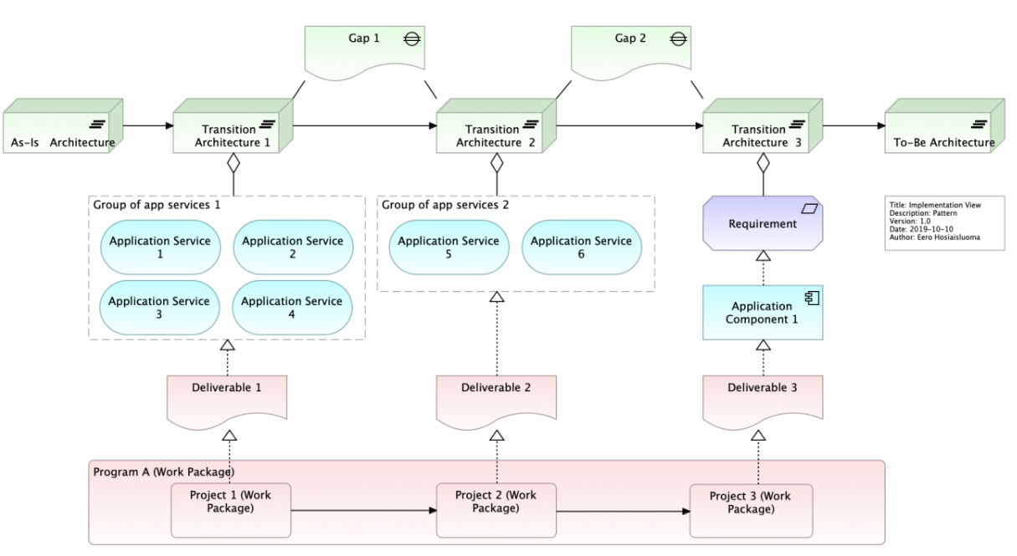
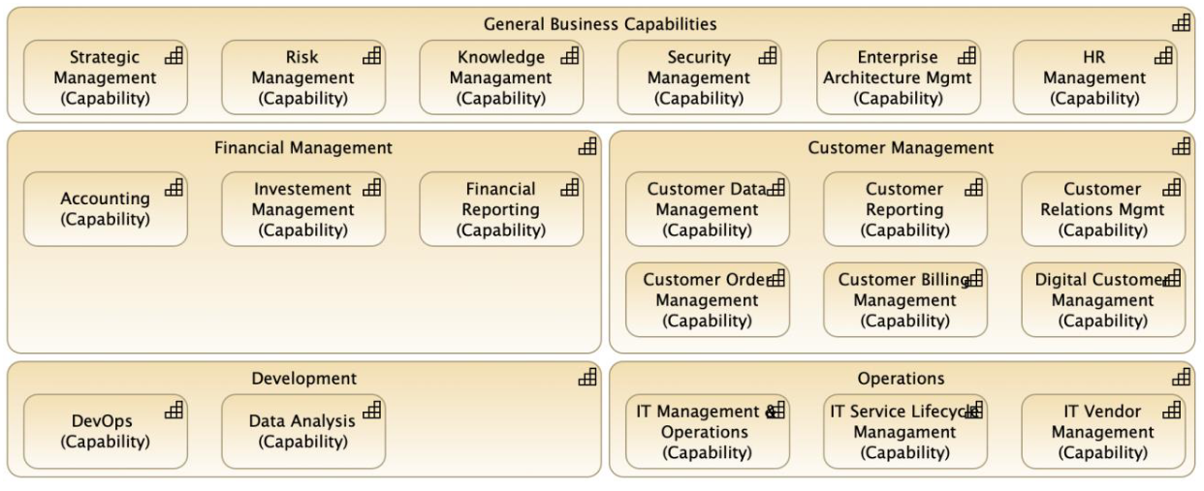
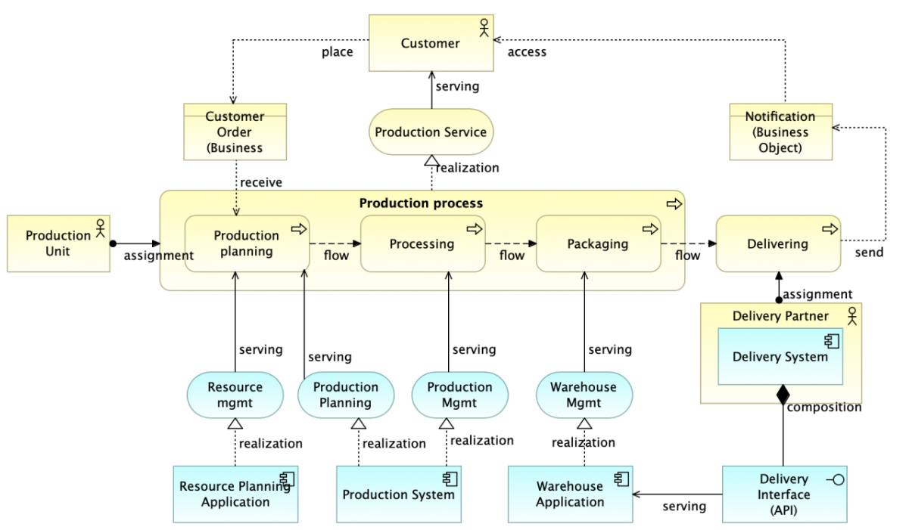

Slide 5
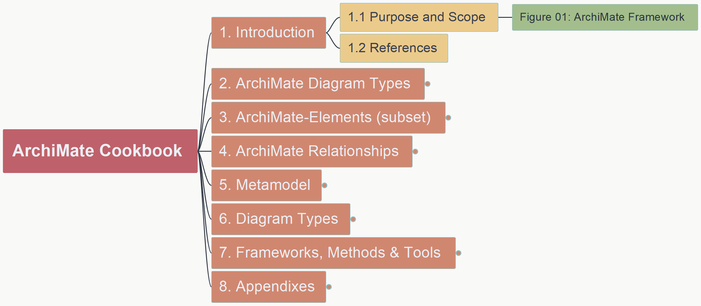
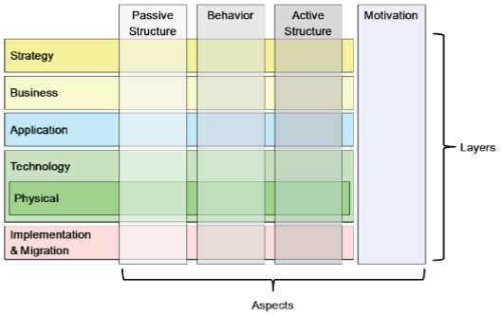
ArchiMate Cookbook
001
1.1 Purpose and Scope

Slide 6
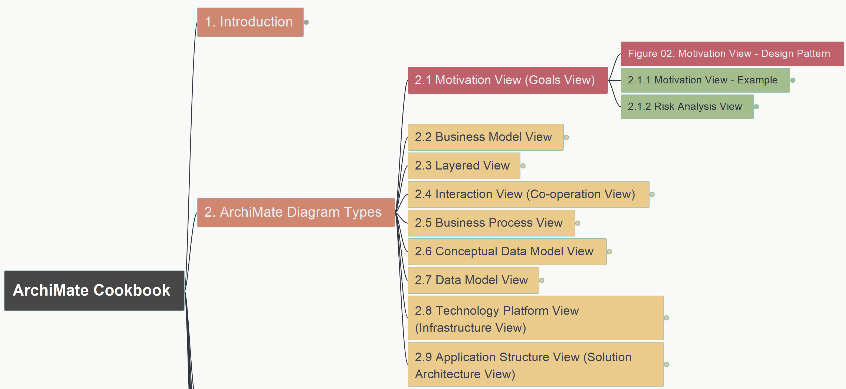
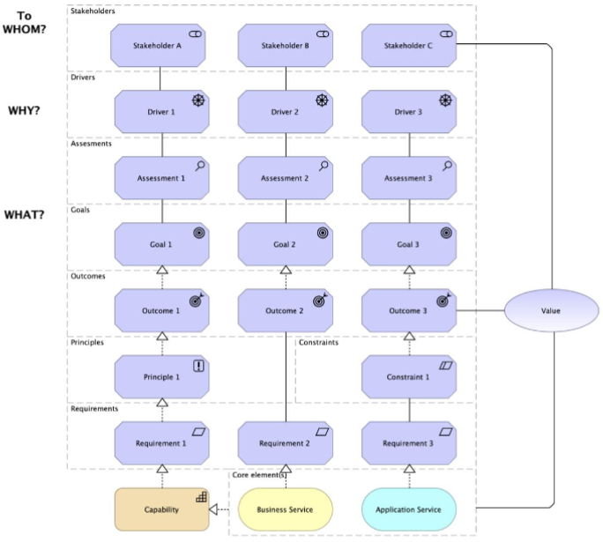
ArchiMate Cookbook
002
2.1 Motivation View (Goals View) – Figure 02

Slide 7
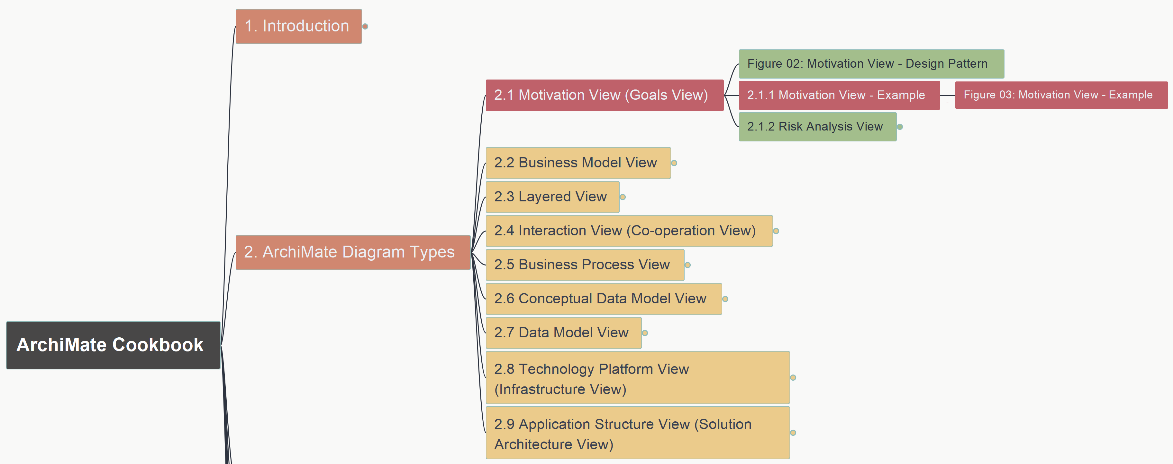
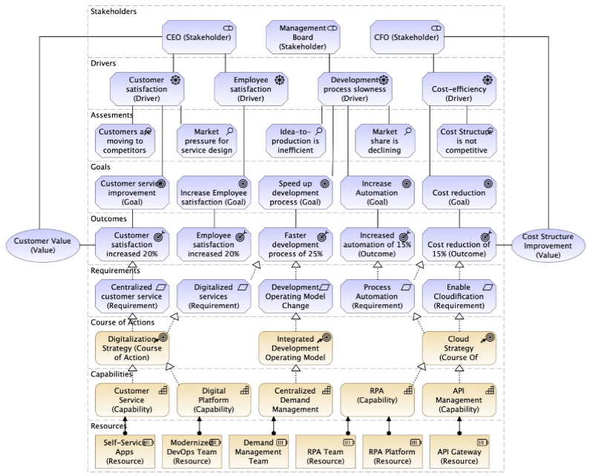
ArchiMate Cookbook
003
2.1 Motivation View (Goals View) – Figure 03

Slide 8
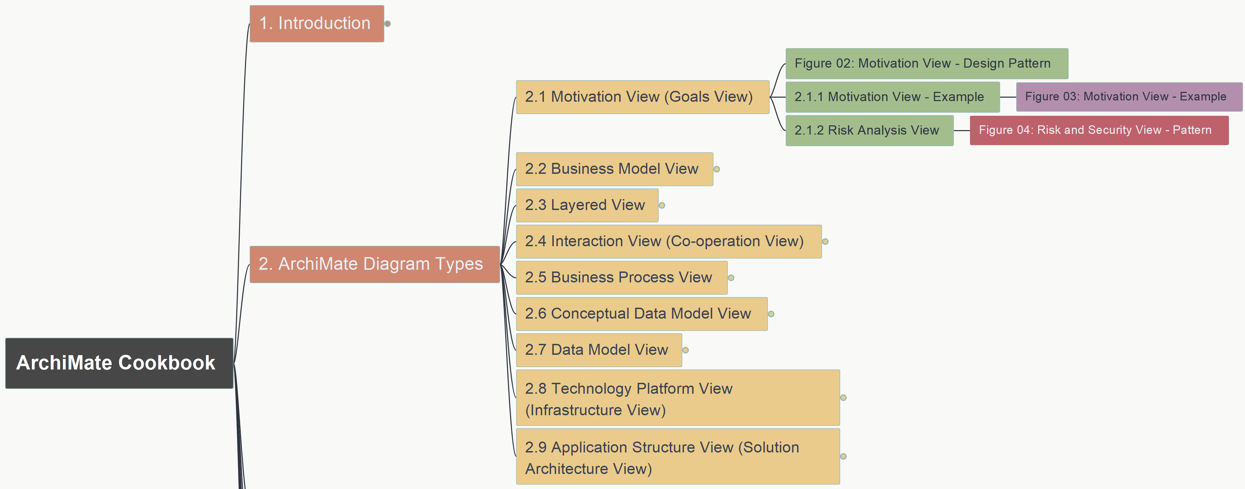
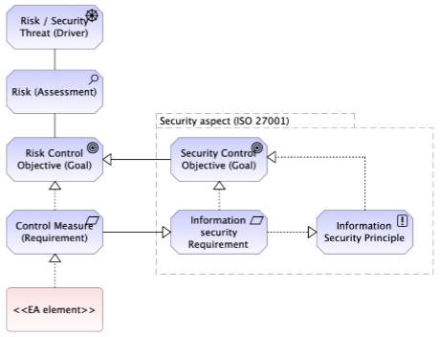
ArchiMate Cookbook
004
2.1 Motivation View (Goals View) – Figure 04

Slide 9
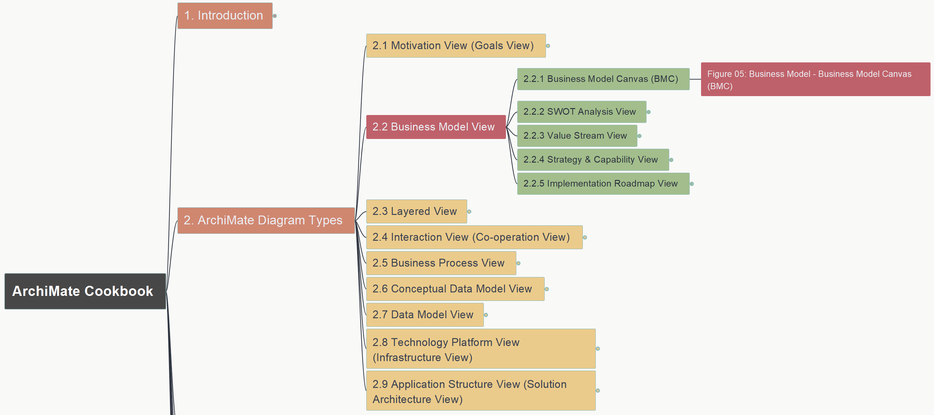
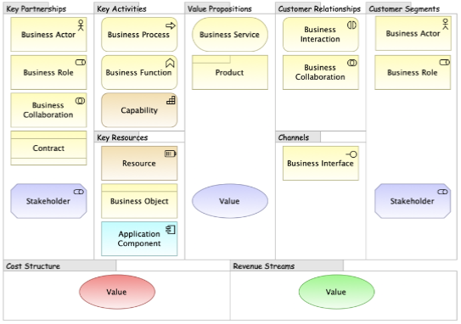
ArchiMate Cookbook
005
2.2 Business Model View – 2.2.1 BMC Figure 05

Slide 10
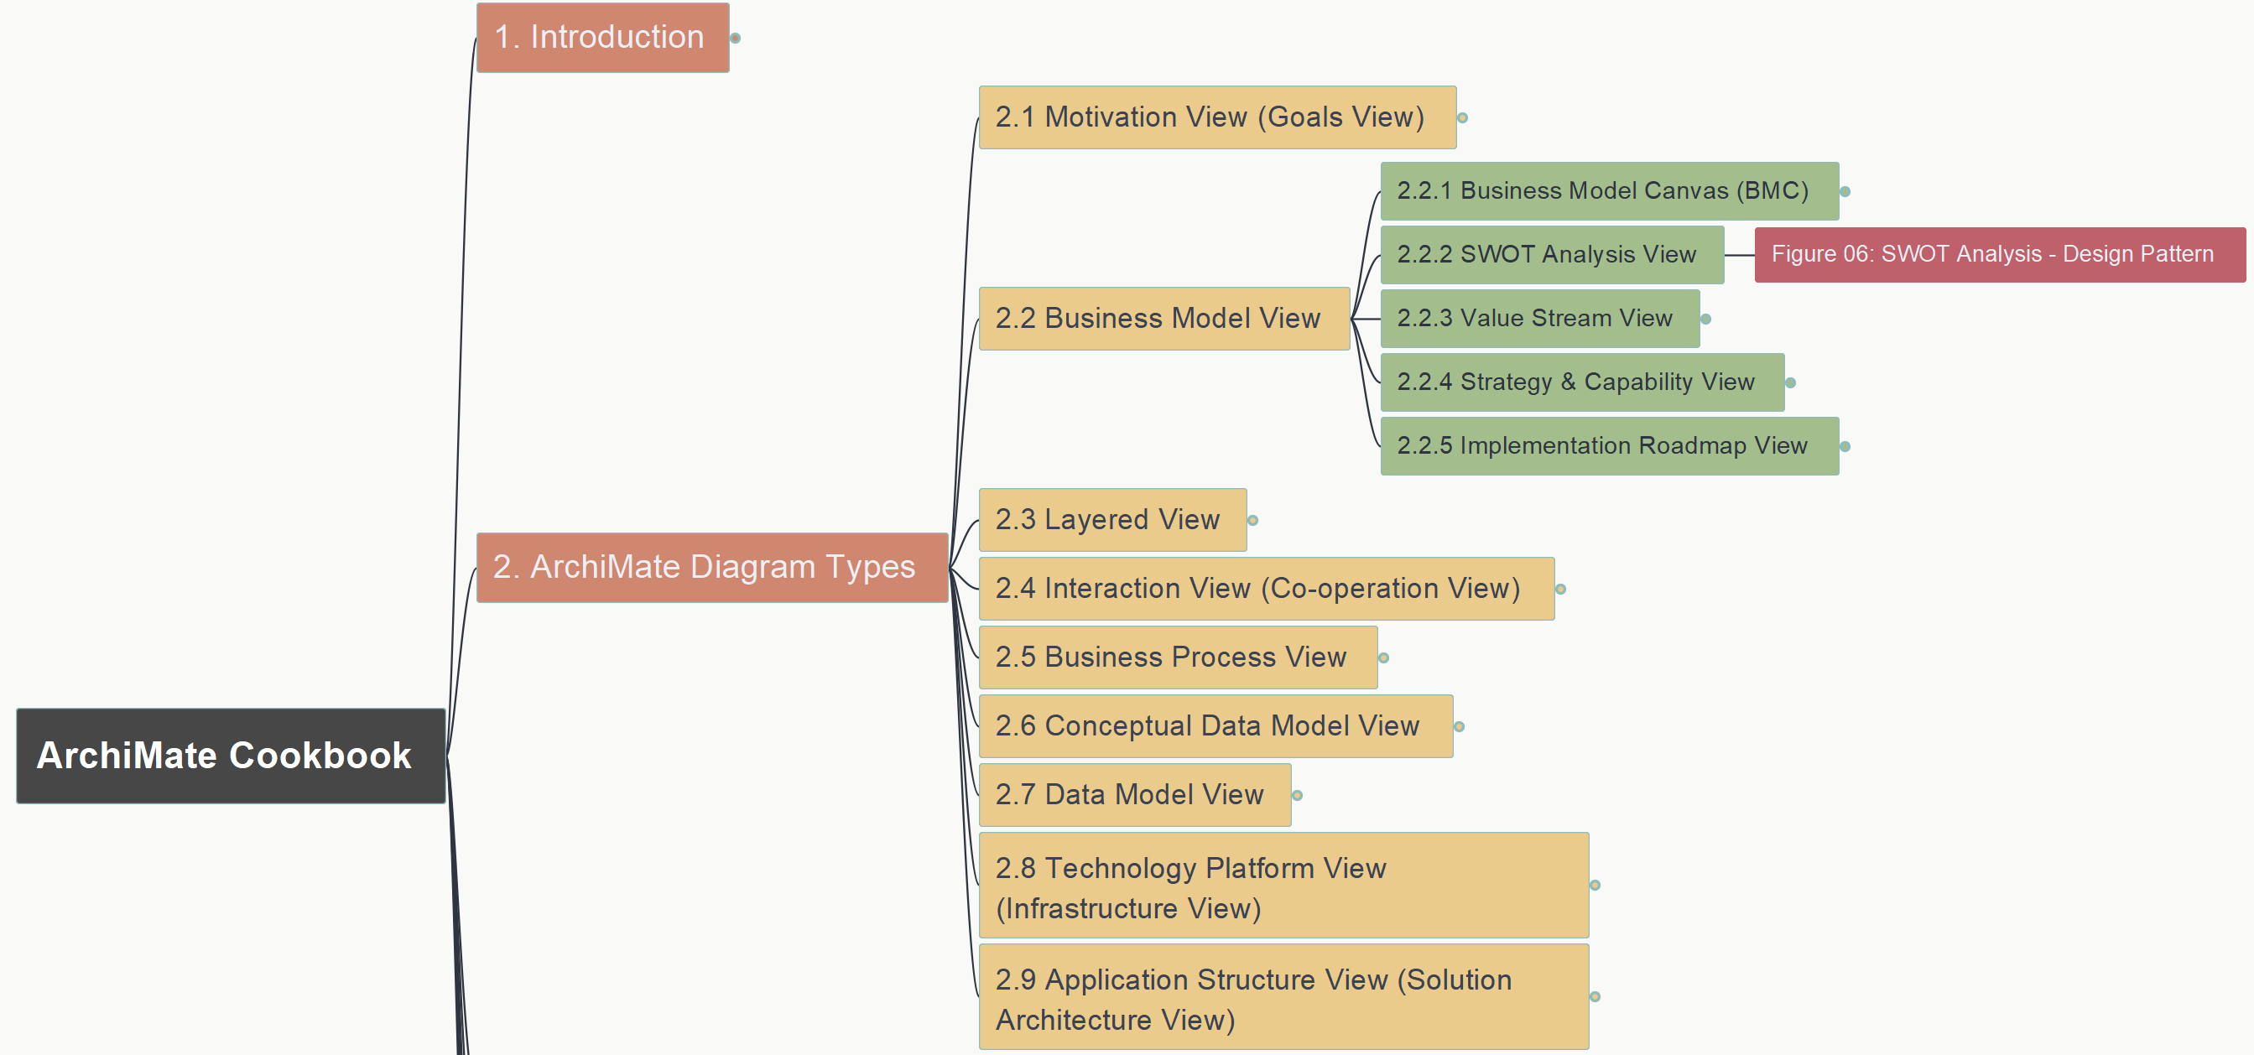
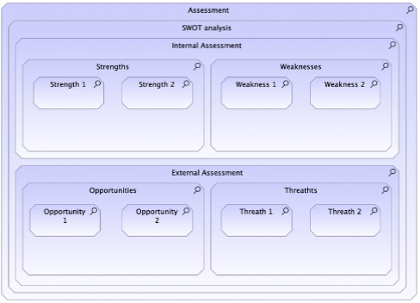
ArchiMate Cookbook
006
2.2 Business Model View – 2.2.2 SWOT Figure 06

Slide 11
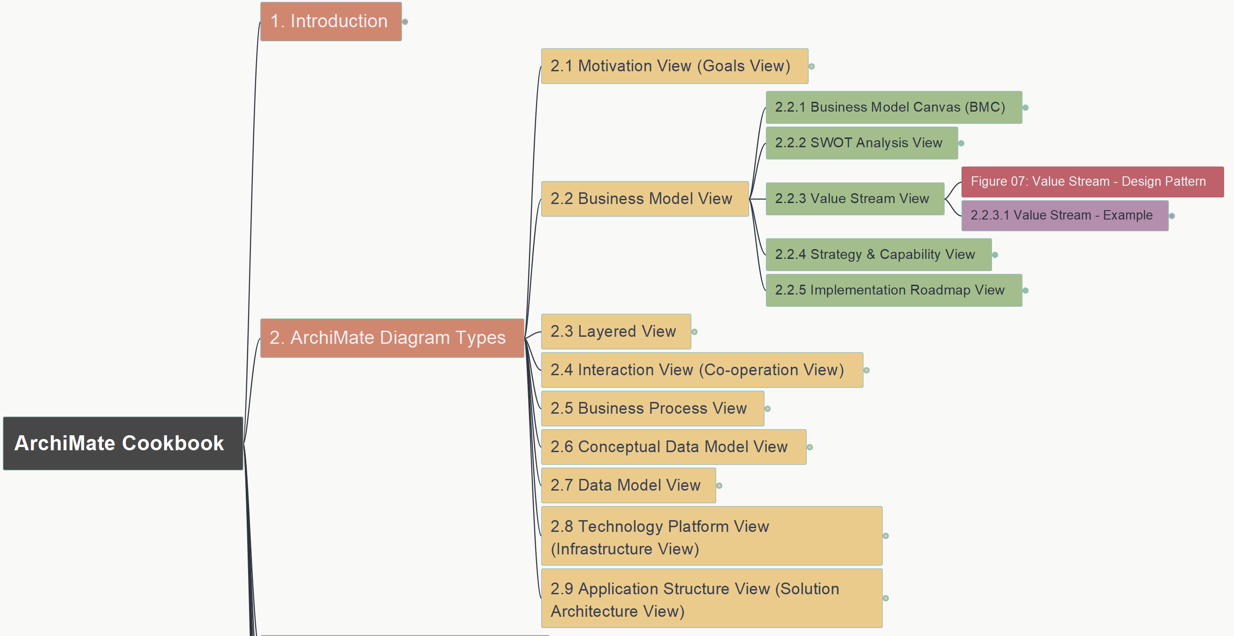
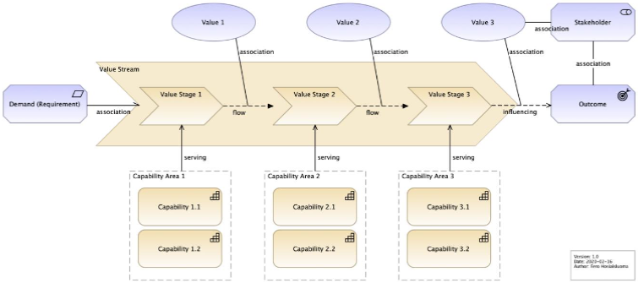
ArchiMate Cookbook
007
2.2 Business Model View – 2.2.3 Value Stream
Figure 07

Slide 12
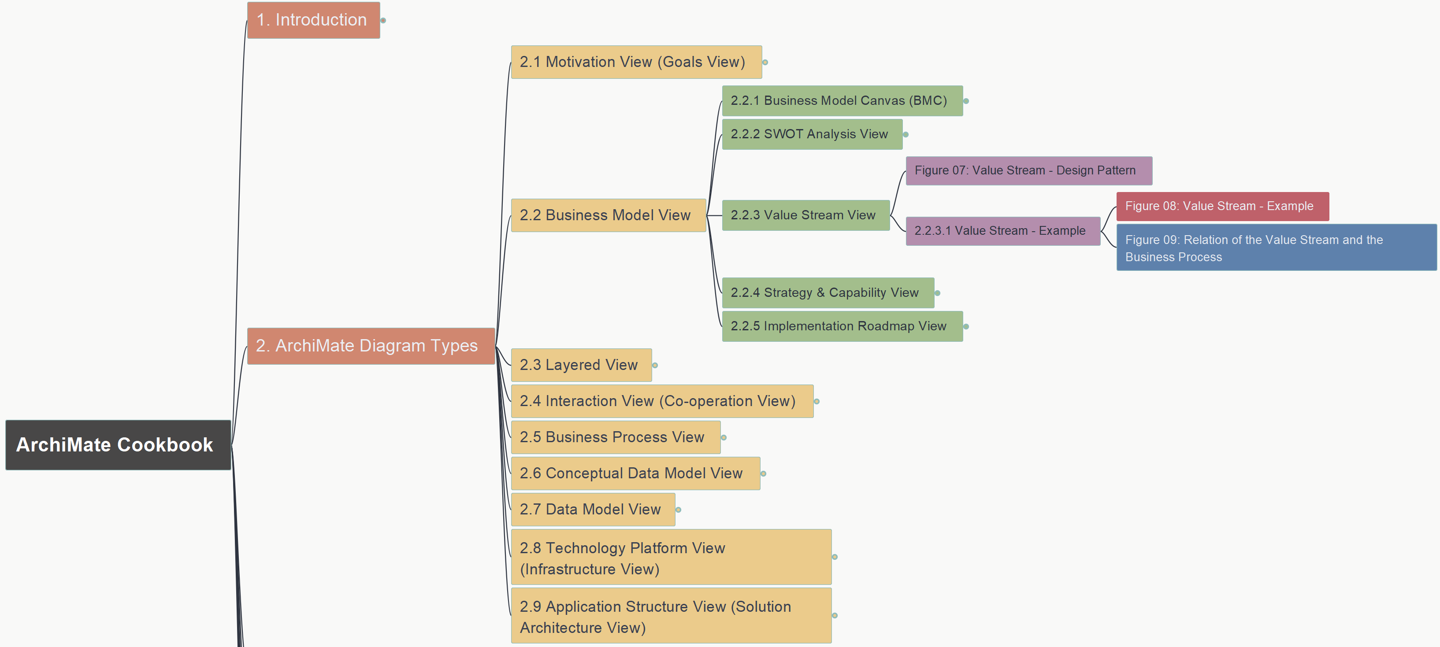
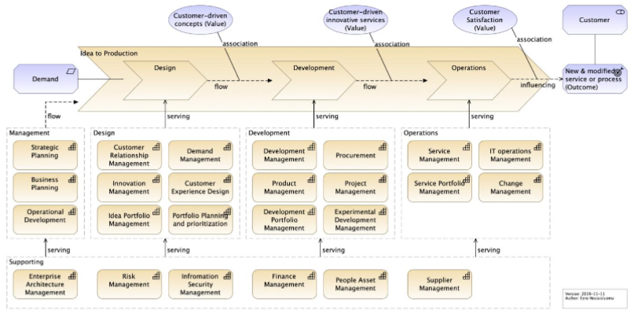
ArchiMate Cookbook
008
2.2 Business Model View – 2.2.3 Value Stream
2-2-3-1 Figure 08

Slide 13
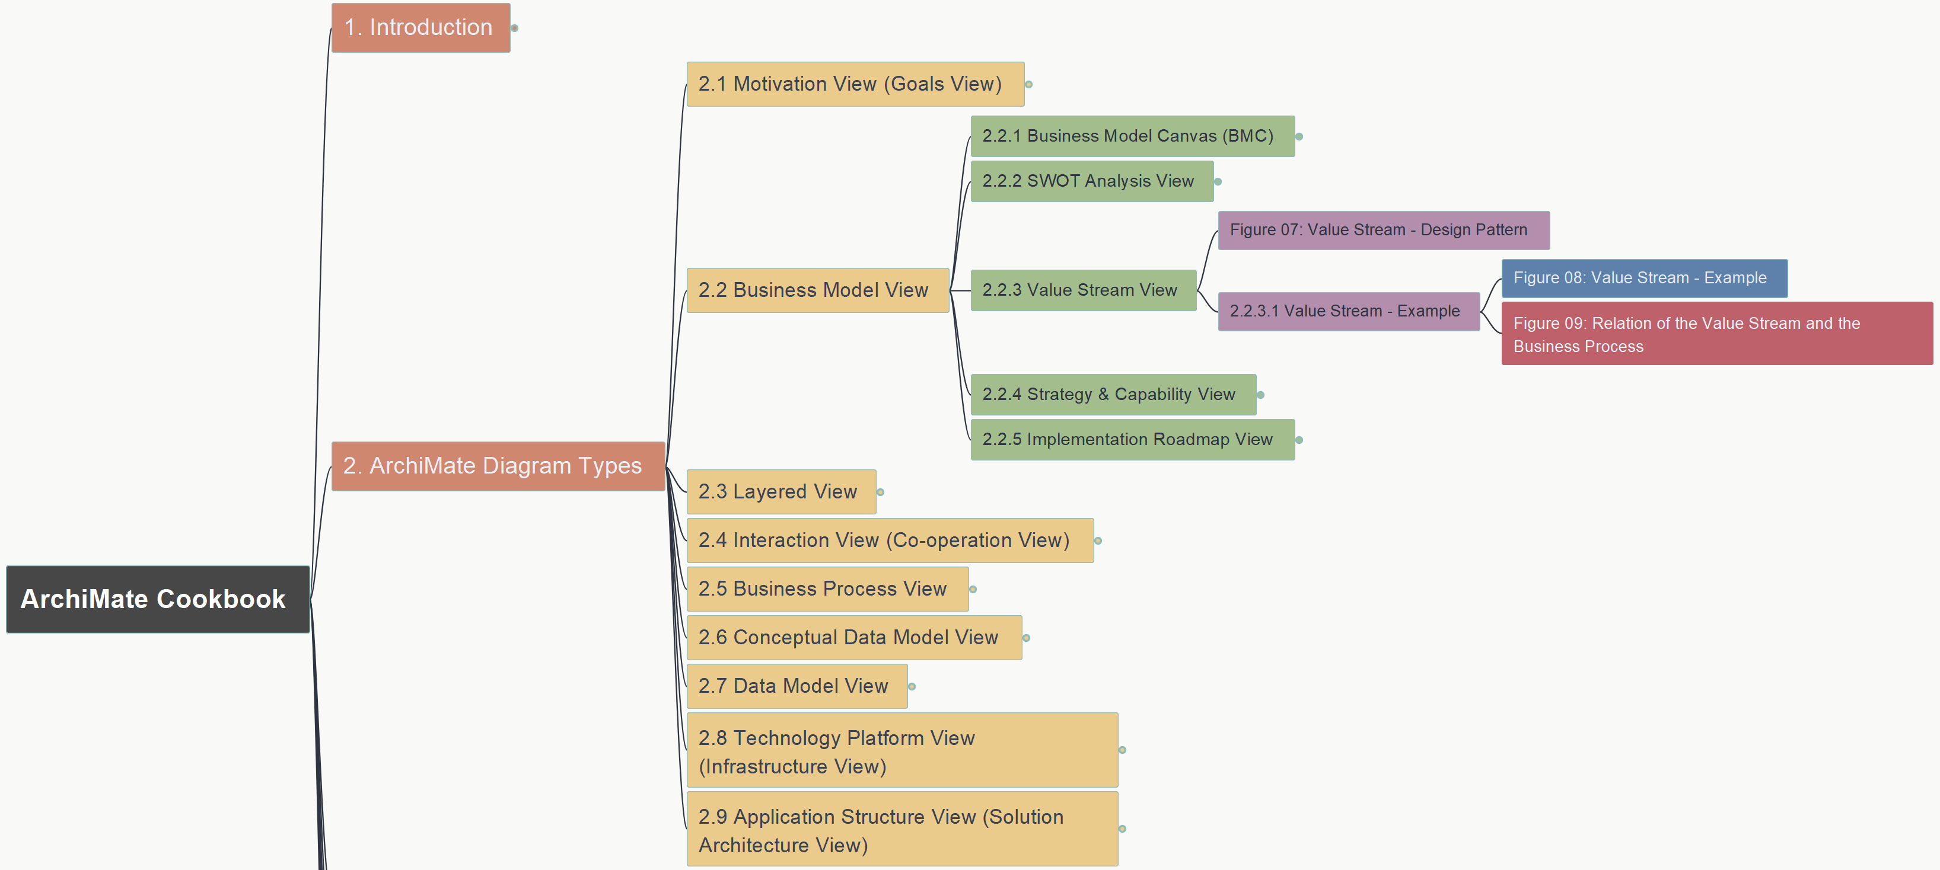
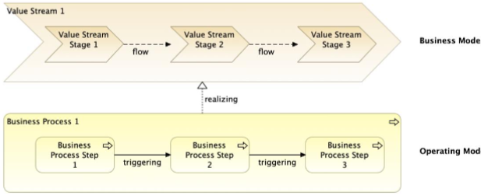
ArchiMate Cookbook
009
2.2 Business Model View – 2.2.3 Value Stream
Figure 09 – Value Stream x Business Process

Slide 14
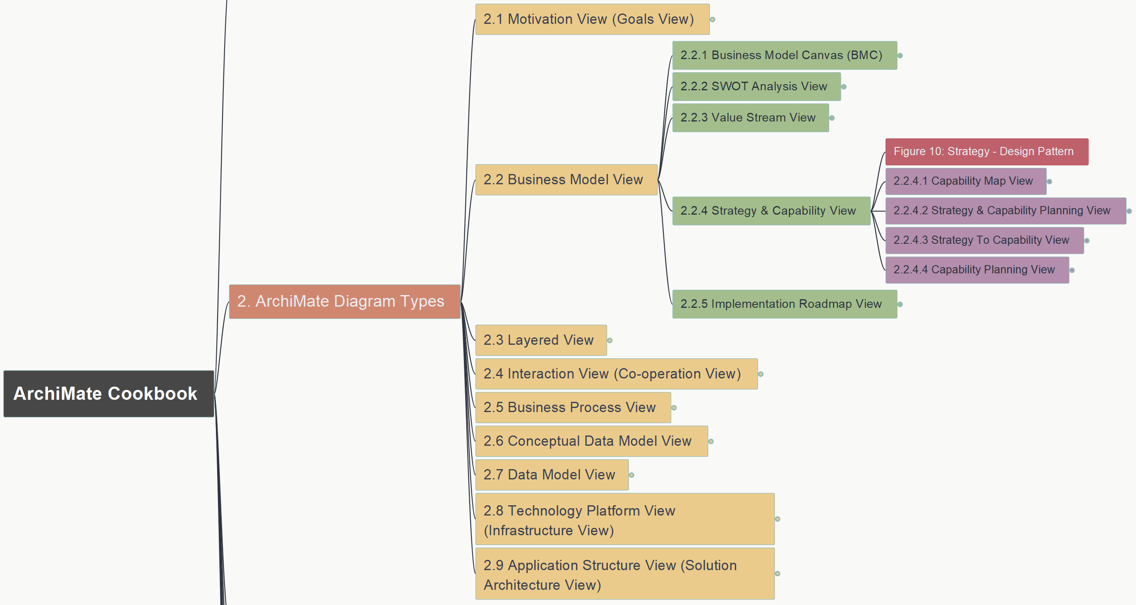
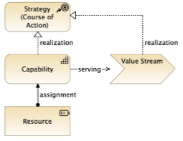
ArchiMate Cookbook
010
2.2 Business Model View – 2.2.4 Strategy & Capability
Figure 10: Strategy – Design Pattern

Slide 15
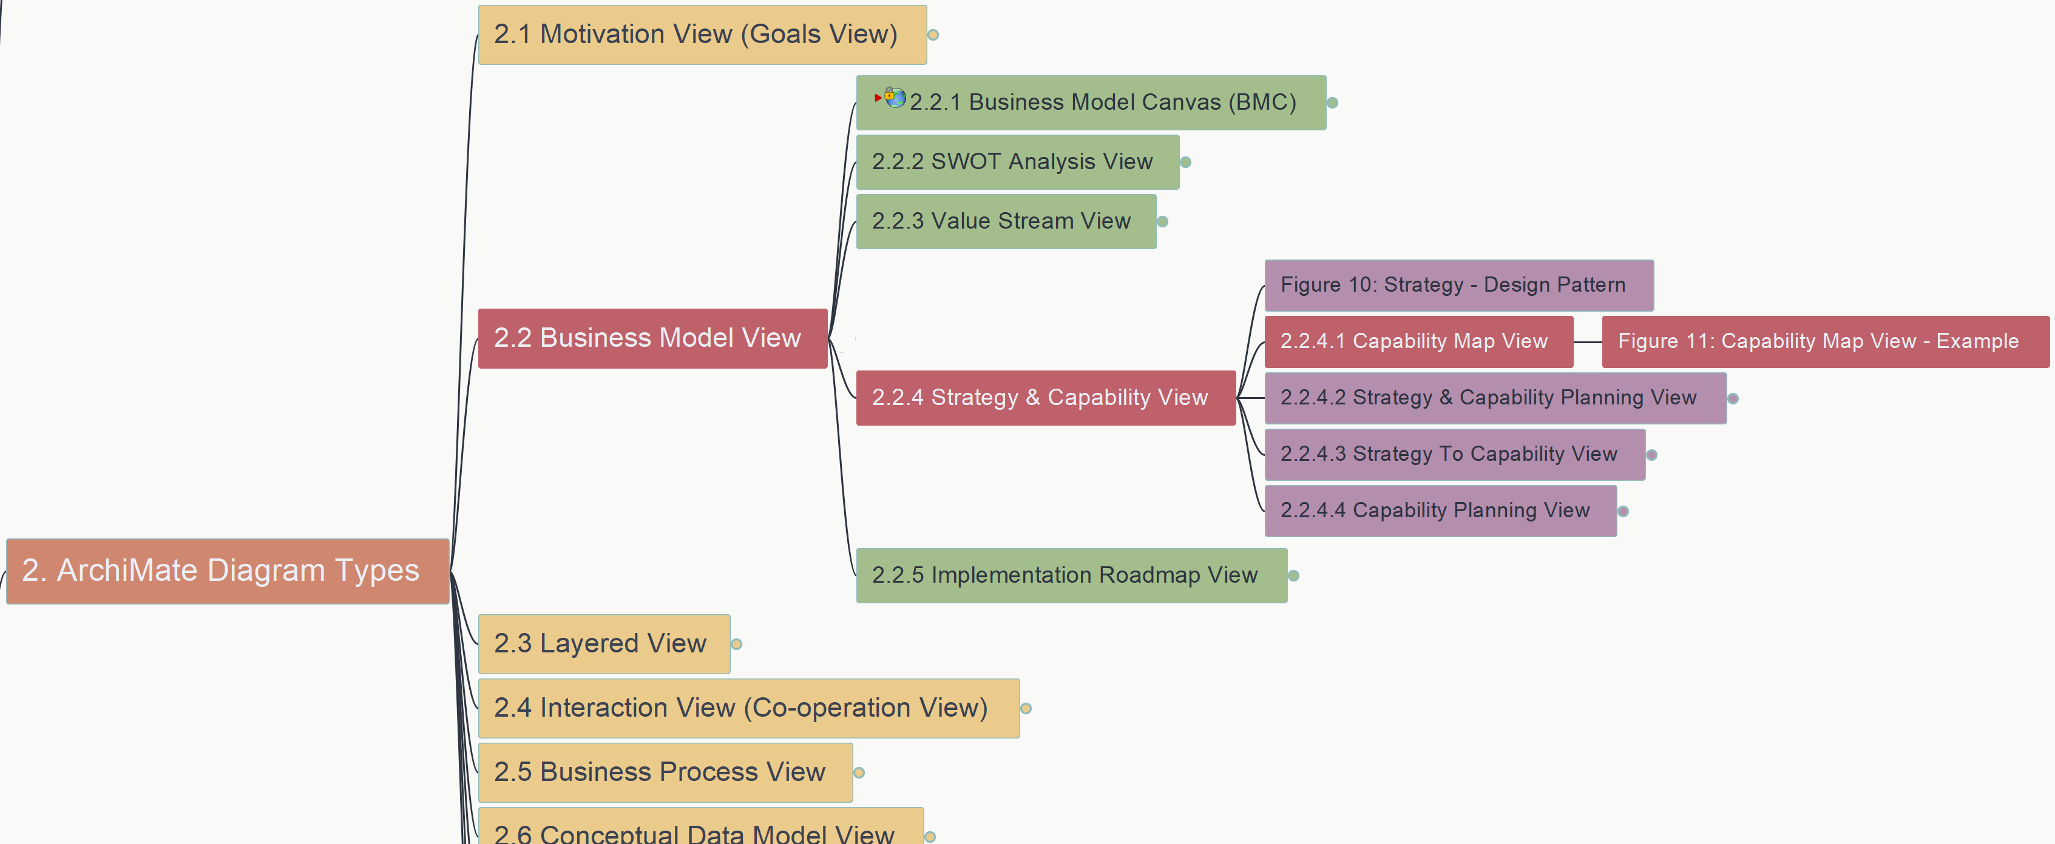
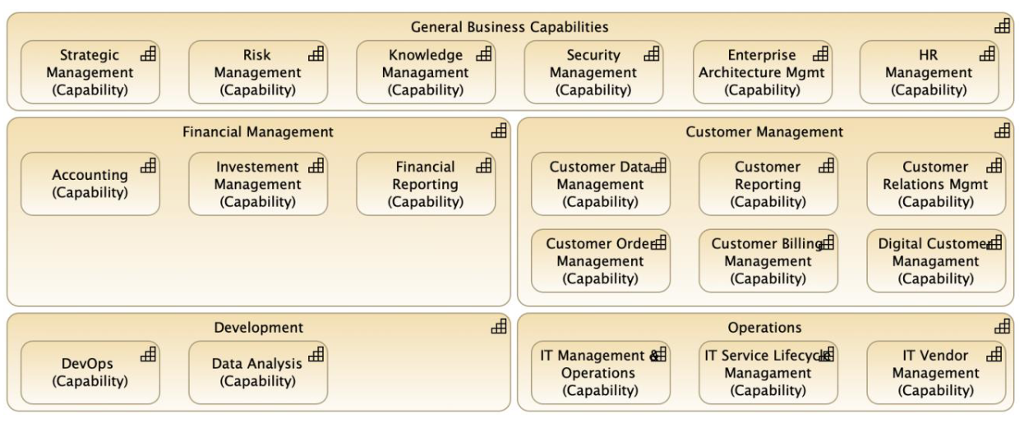
ArchiMate Cookbook
011
2.2 Business Model View – 2.2.4 Strategy & Capability
2.2.4.1 Figure 11: Capability Map View - Example

Slide 16
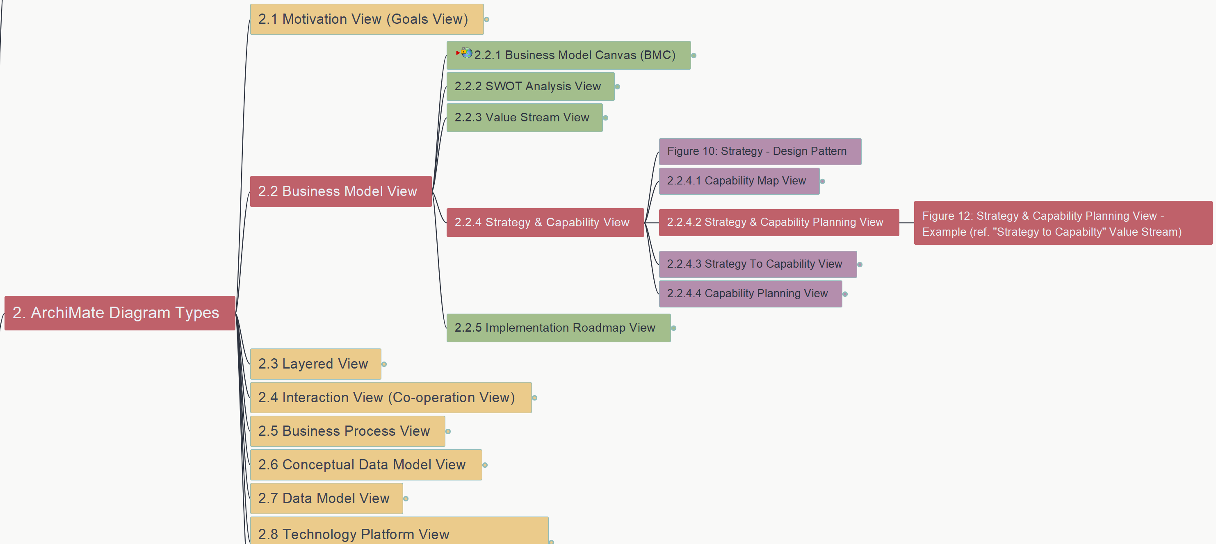
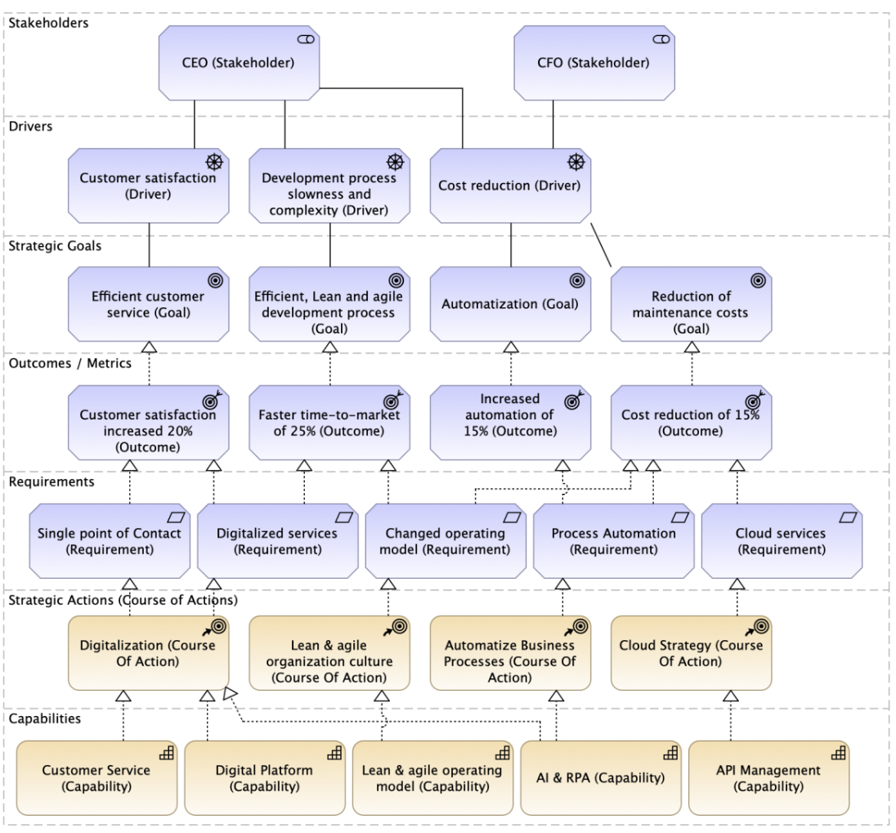
ArchiMate Cookbook
012
2.2 Business Model View – 2.2.4 Strategy & Capability
2.2.4.2 Figure 12: Strategy & Capability Planning View

Slide 17
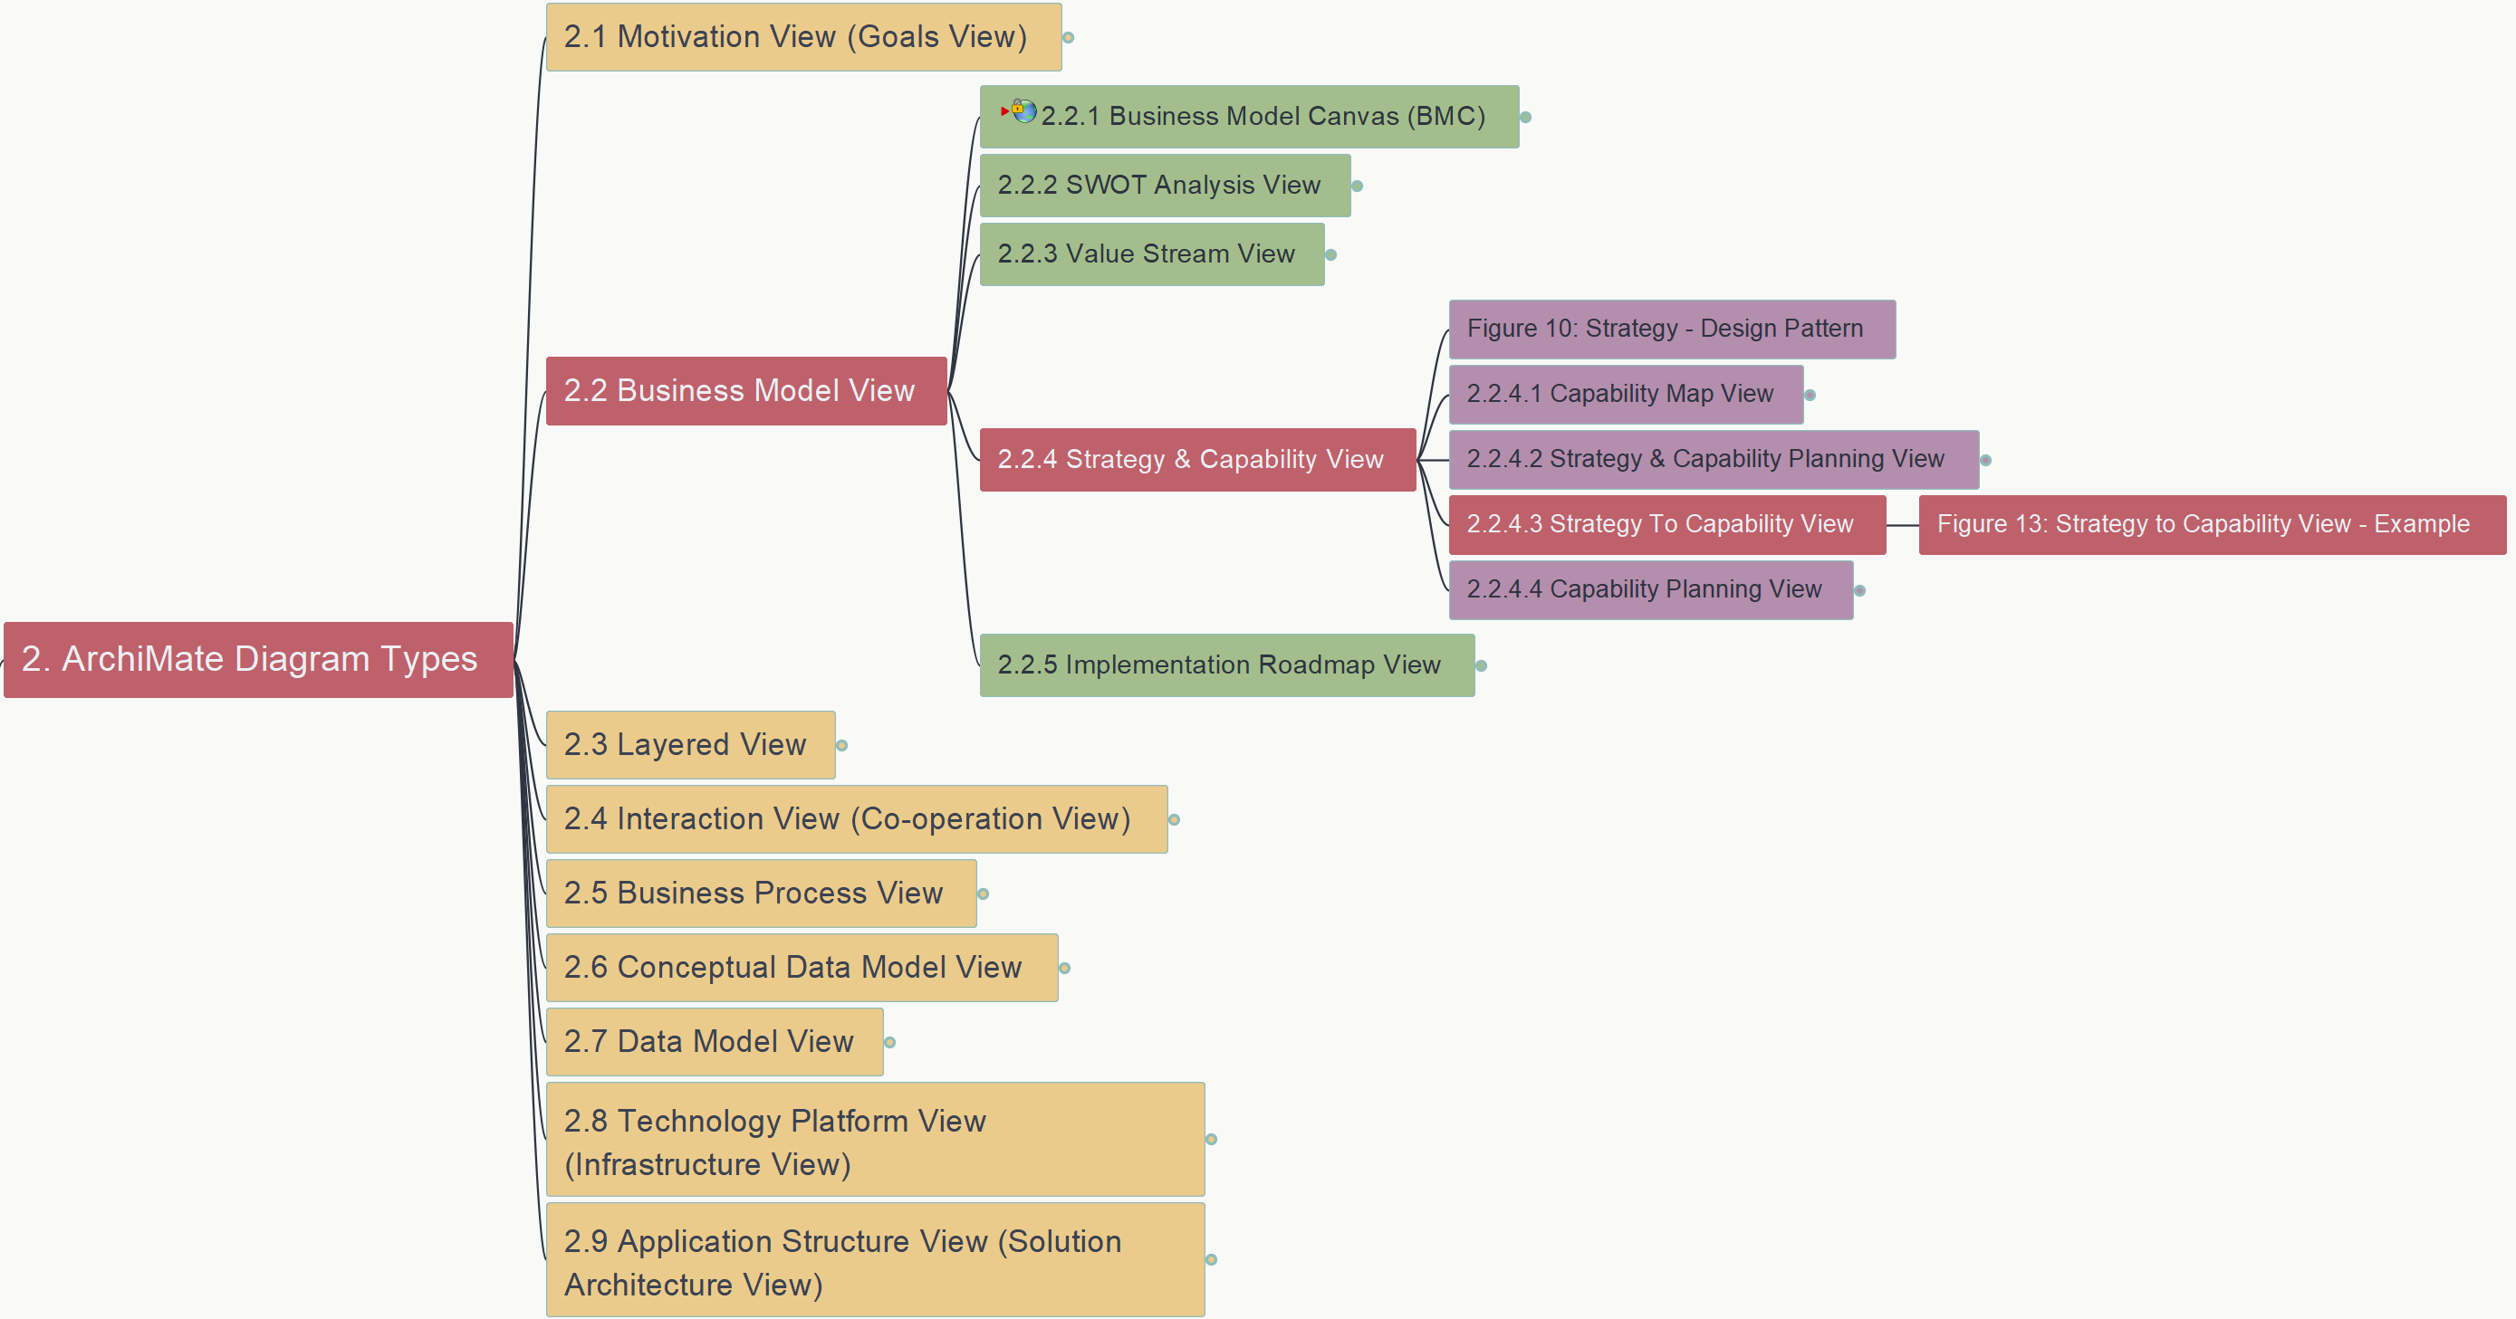
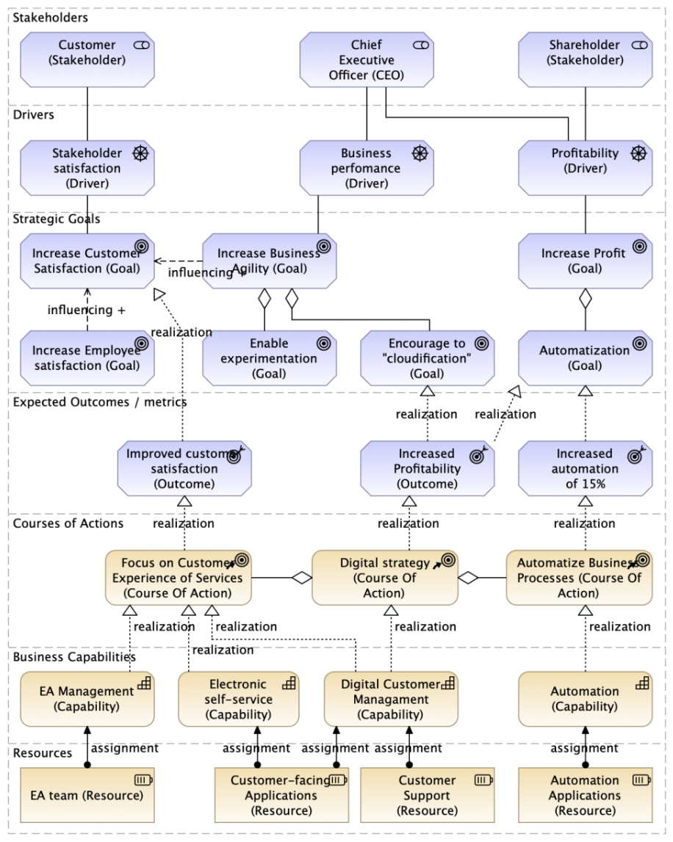
ArchiMate Cookbook
013
2.2 Business Model View – 2.2.4 Strategy & Capability
2.2.4.3 Figure 13: Strategy To Capability View

Slide 18
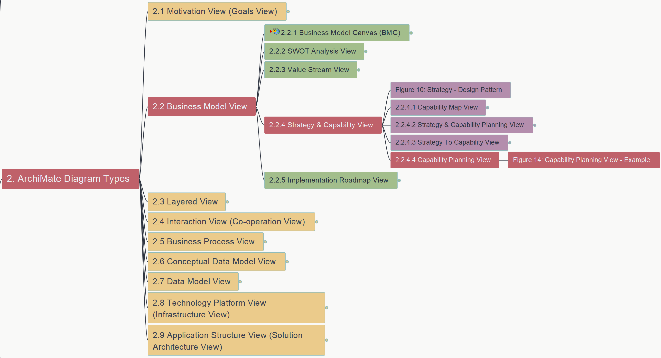
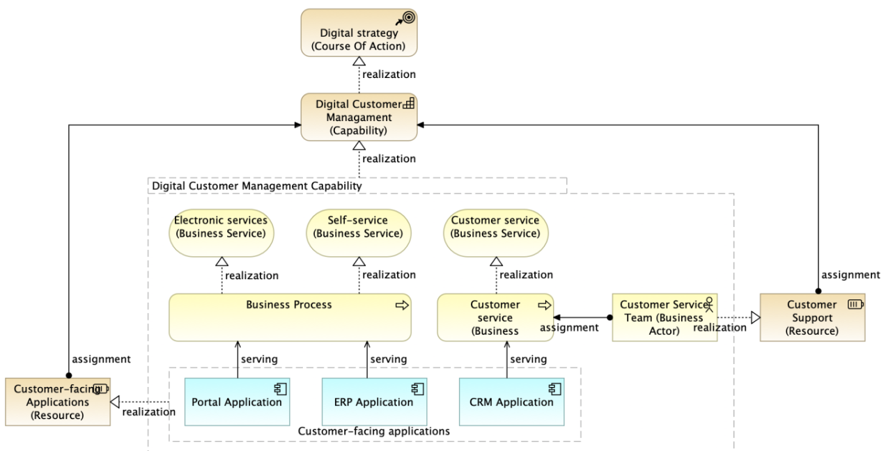
ArchiMate Cookbook
014
2.2 Business Model View – 2.2.4 Strategy & Capability
2.2.4.4 Figure 14: Capability Planning View

Slide 19
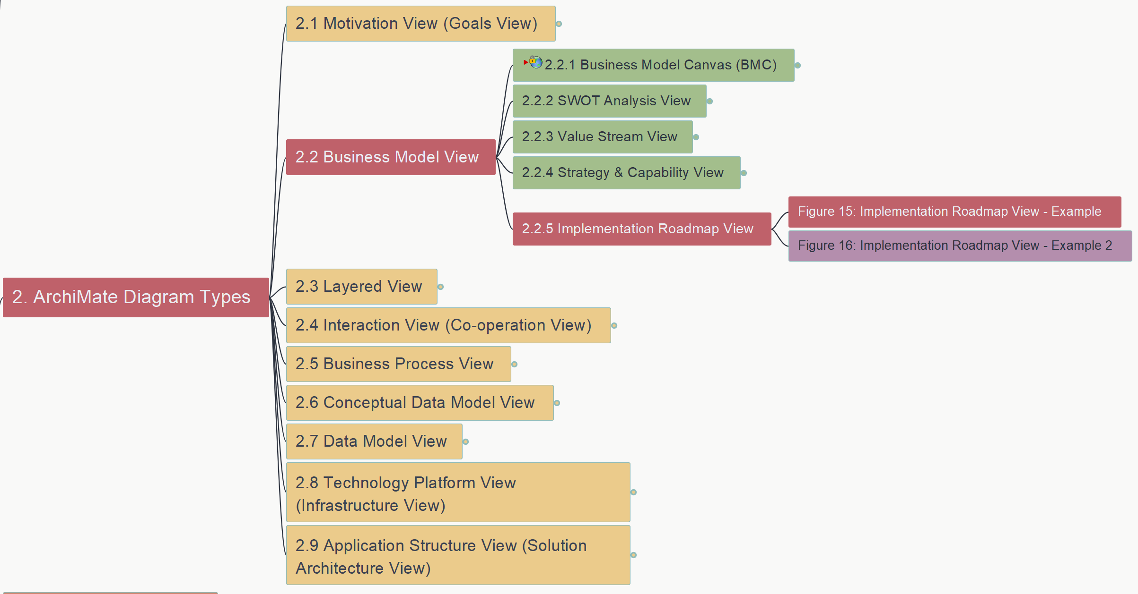
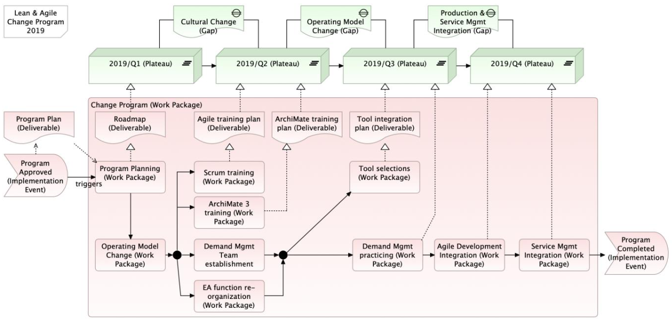
ArchiMate Cookbook
015
2.2 Business Model View – 2.2.5 Implementation Roadmap View
Figure 15: Implementation Roadmap View – Example 1

Slide 20
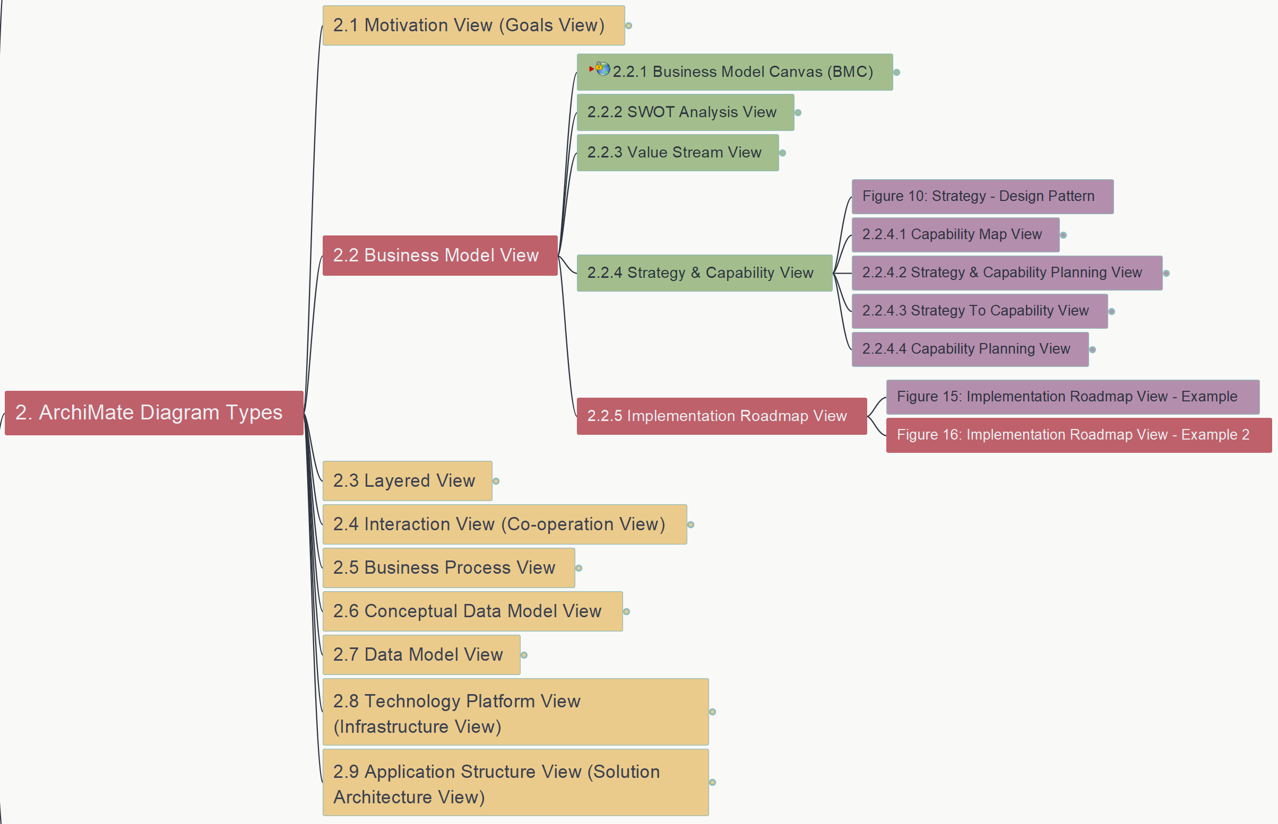
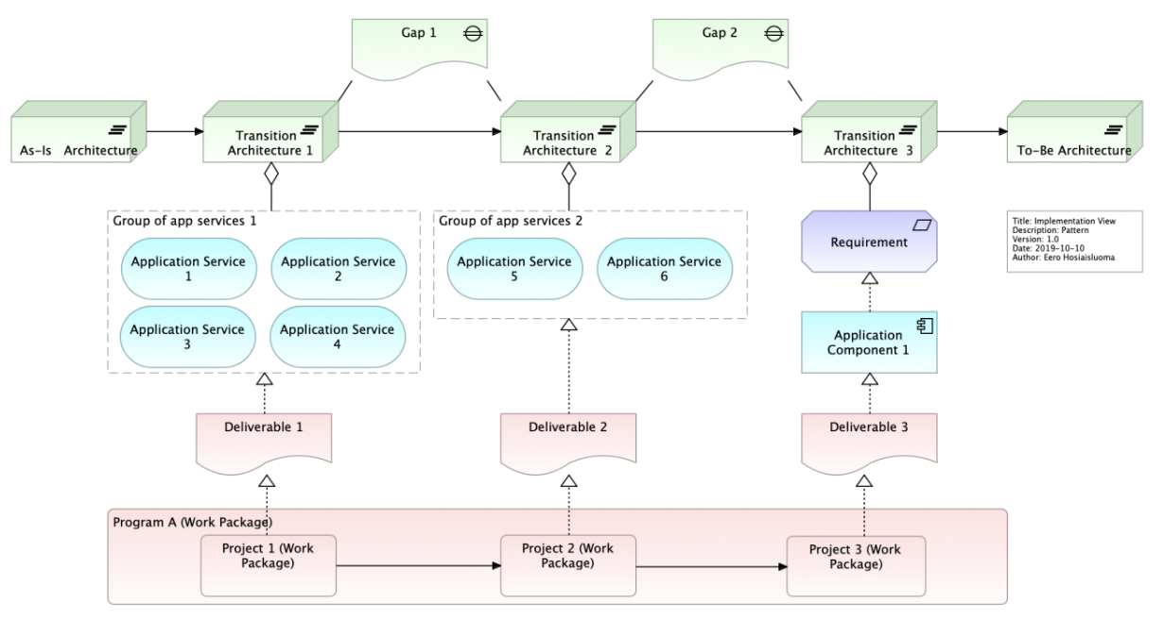
ArchiMate Cookbook
016
2.2 Business Model View – 2.2.5 Implementation Roadmap View
Figure 16: Implementation Roadmap View – Example 2

Slide 21
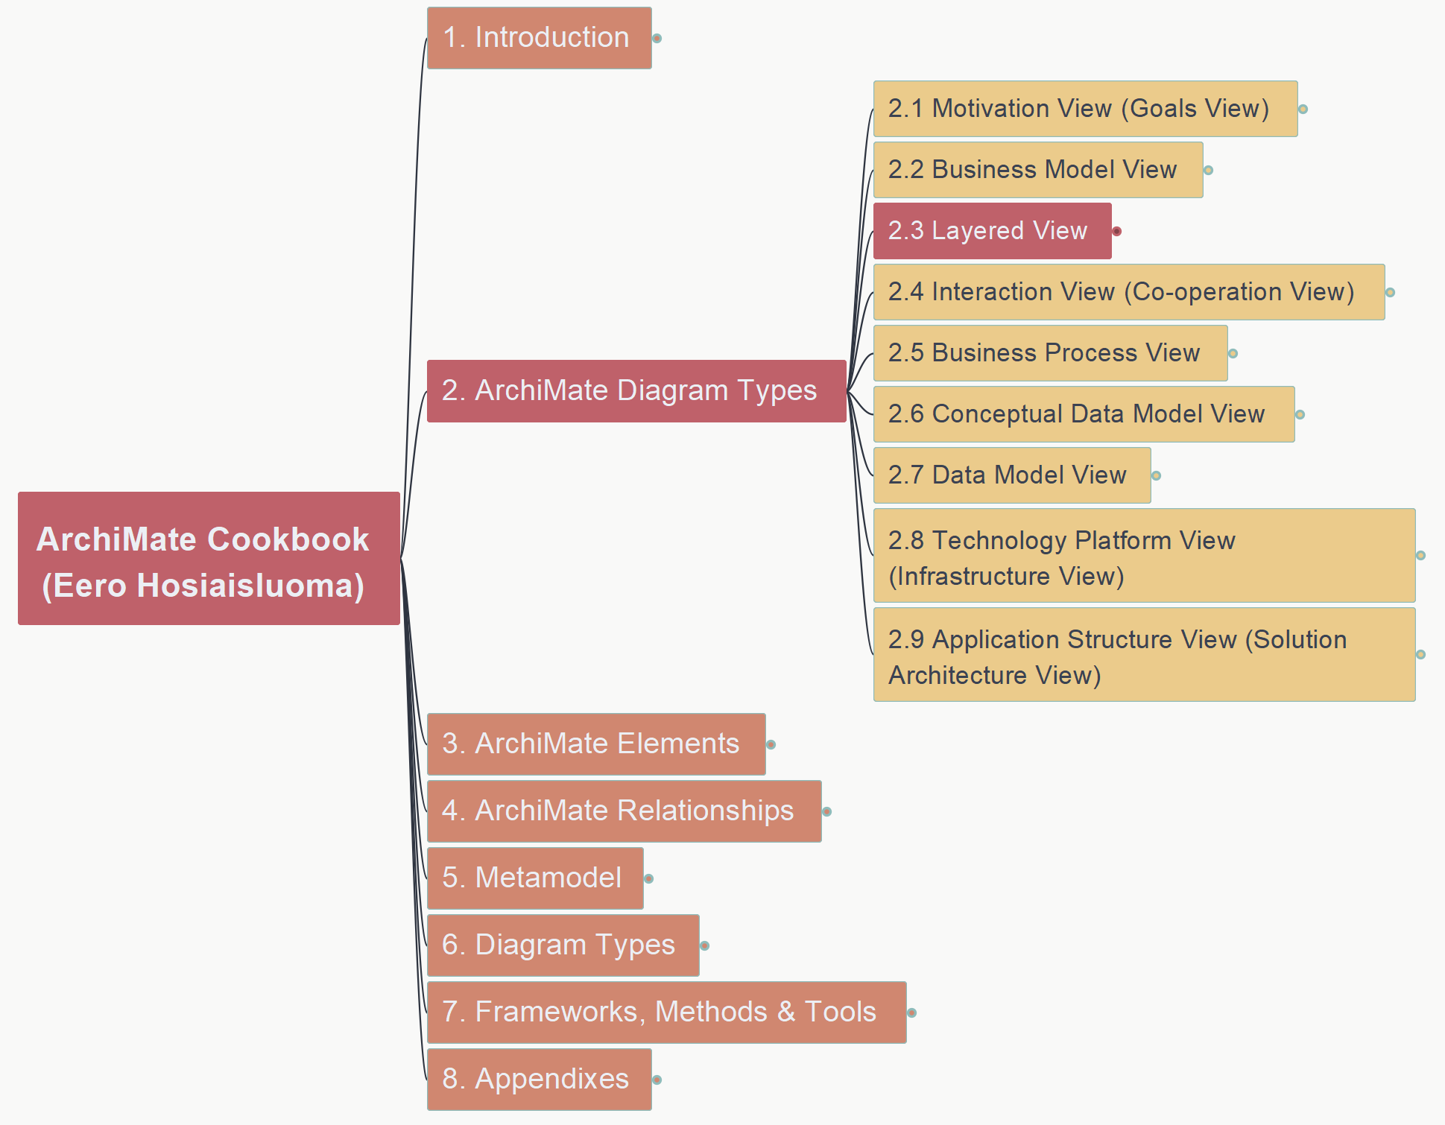
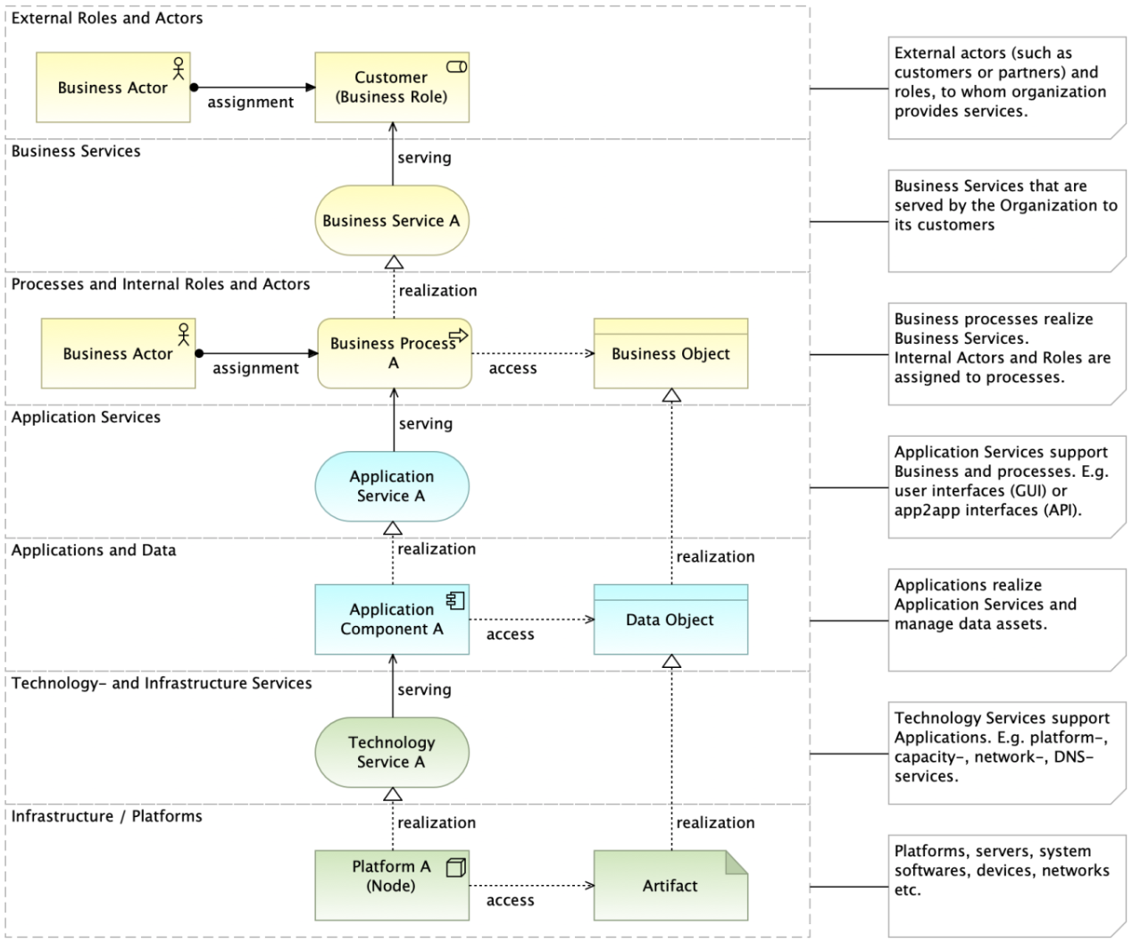
ArchiMate Cookbook
017
2.3 Layered View
Figure 17: Layered View (Overview) – Basic Design Pattern

Slide 22
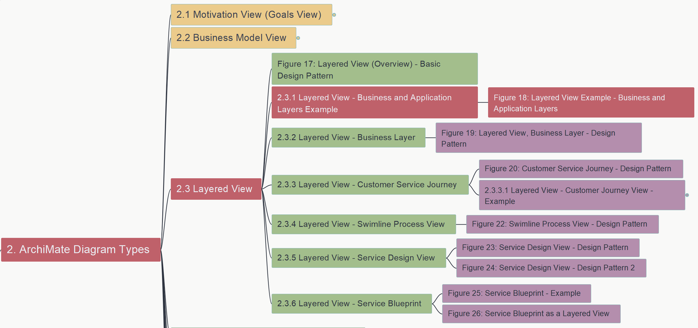
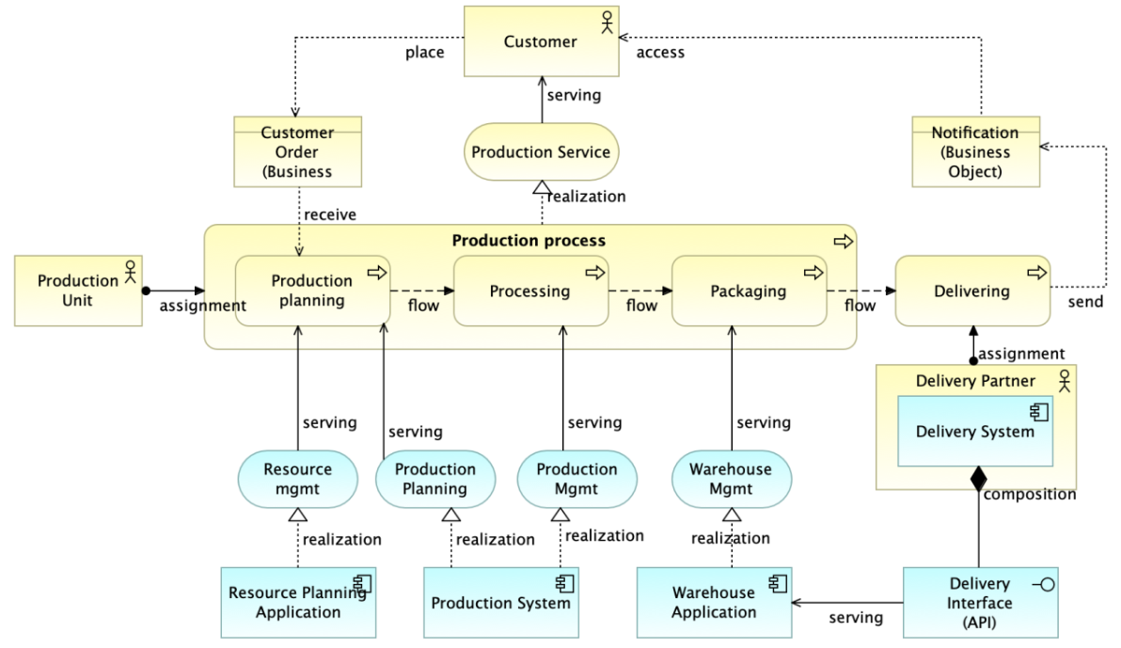
ArchiMate Cookbook
018
2.3 Layered View – 2.3.1 Business- and Application Layers
Figure 18: Layered View Example

Slide 23
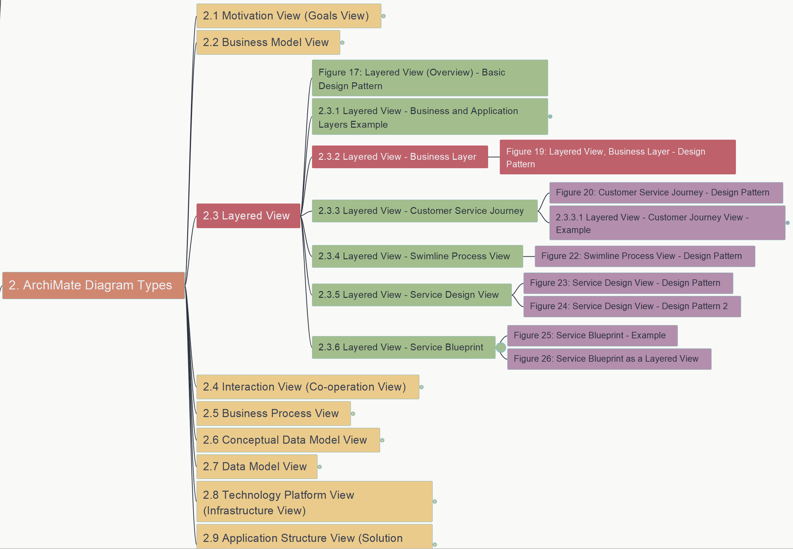
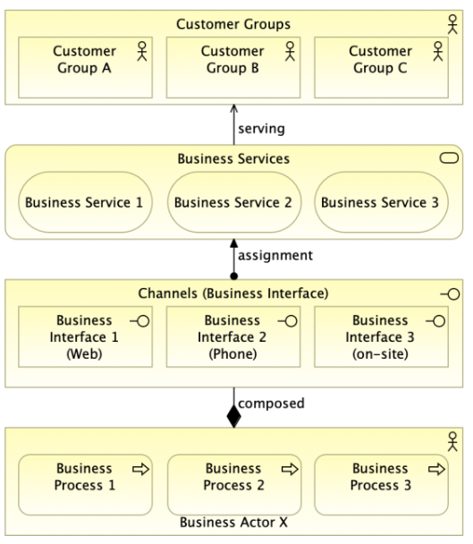
ArchiMate Cookbook
019
2.3 Layered View – 2.3.2 Business Layer
Figure 19: Layered View – Business Layer Design Pattern

Slide 24
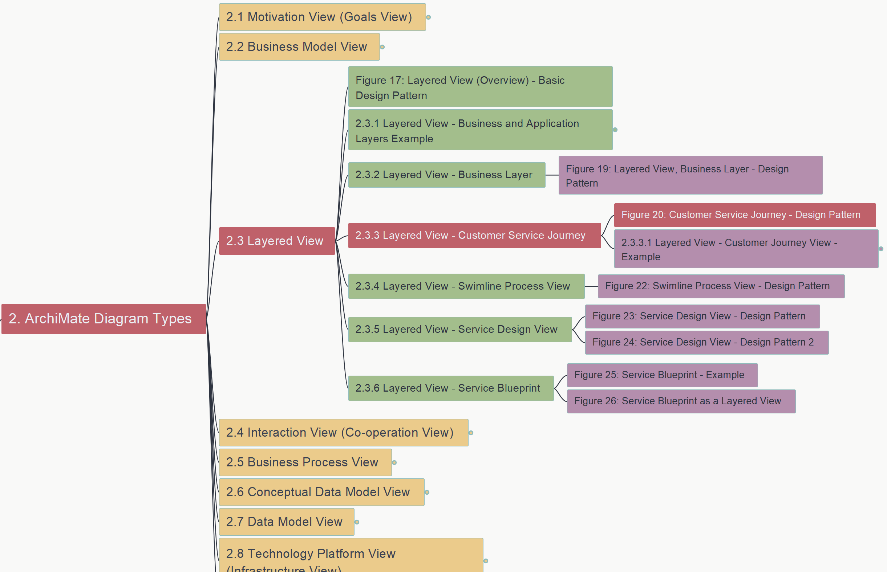
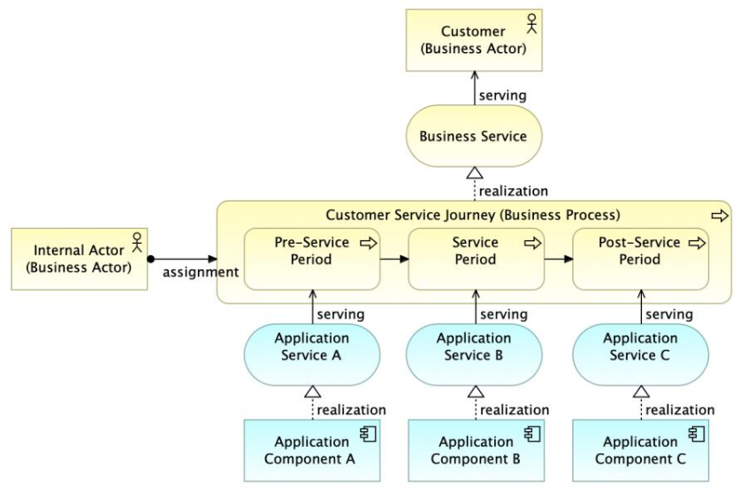
ArchiMate Cookbook
020
2.3 Layered View – 2.3.3 Customer Service Journey
Figure 20: Customer Service Journey - Design Pattern

Slide 25
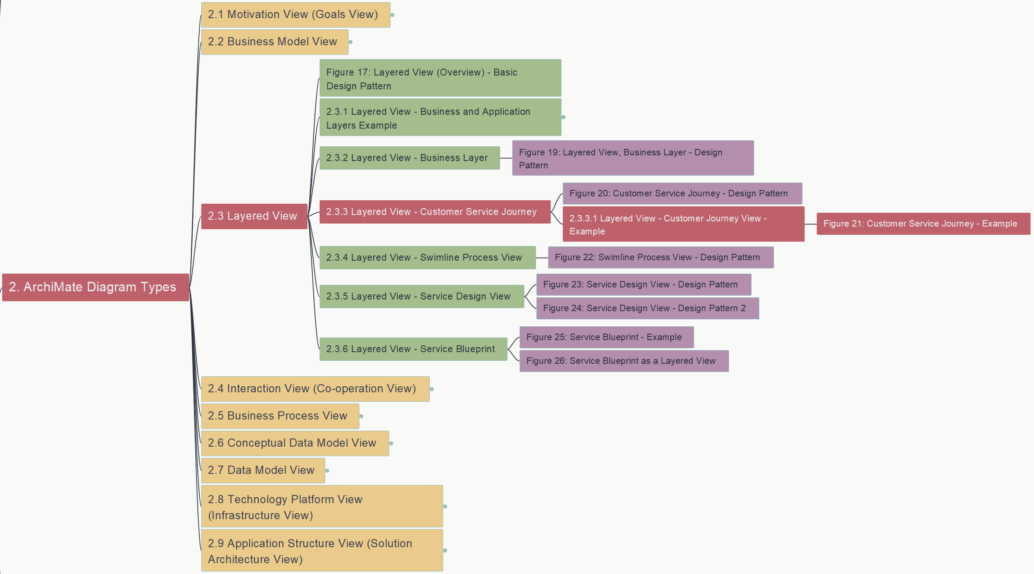
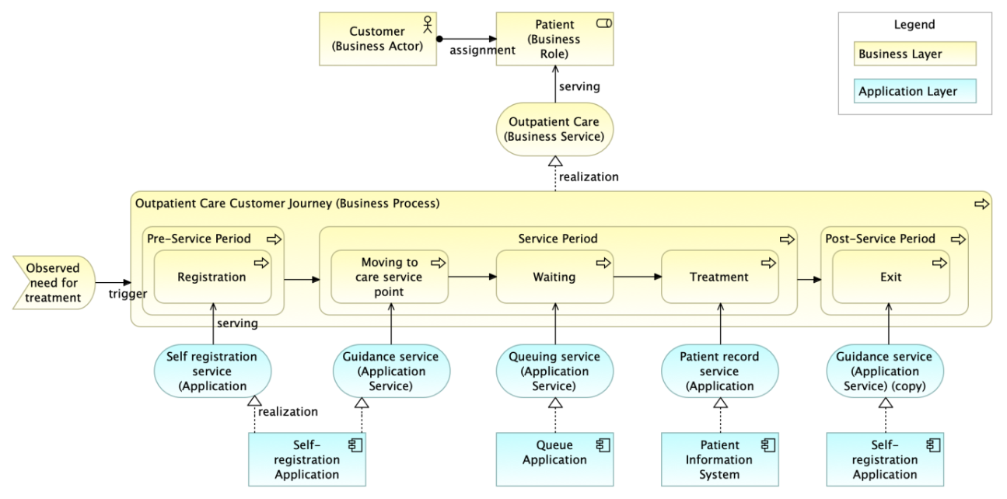
ArchiMate Cookbook
021
2.3 Layered View – 2.3.3 Customer Service Journey
Figure 21: Layered View – Sample for CSJ

Slide 26


ArchiMate Cookbook
022
2.3 Layered View – 2.3.4 Swimline Process View
Figure 22: Swimline Process View – Design Pattern

Slide 27


ArchiMate Cookbook
023
2.3 Layered View – 2.3.5 Service Design View
Figure 23: Service Design View – Design Pattern 1

Slide 28


ArchiMate Cookbook
024
2.3 Layered View – 2.3.5 Service Design View
Figure 24: Service Design View – Design Pattern 2

Slide 29


ArchiMate Cookbook
025
2.3 Layered View – 2.3.6 Service Blueprint
Figure 25: Service Blueprint - Example

Slide 30


ArchiMate Cookbook
026
2.3 Layered View – 2.3.6 Service Blueprint
Figure 26: Service Blueprint as a Layered View

Slide 31


ArchiMate Cookbook
027
2.4 Interaction View – 2.4.1 Actor Interaction View
Figure 27: Actor Interaction (Co-operation) View – Design Pattern

Slide 32


ArchiMate Cookbook
028
2.4 Interaction View – 2.4.2 Process Interaction (Co-operation) View
Figure 28: Process Interaction View – Design Pattern

Slide 33


ArchiMate Cookbook
029
2.4 Interaction View – 2.4.3 Application Interaction (Co-operation) View
Figure 29: Application Interaction View – Design Pattern

Slide 34


ArchiMate Cookbook
030
2.5 Business Process View
Figure 30: Process View - Example

Slide 35


ArchiMate Cookbook
031
2.5 Business Process View – 2.5.1 Business Process Functional Decomposition
Figure 31: Business Function View

Slide 36


ArchiMate Cookbook
032
2.5 Business Process View – 2.5.1 Business Process Functional Decomposition
Figure 32: Business Process Map

Slide 37


ArchiMate Cookbook
033
2.6 Conceptual Data Model View
Figure 33: Conceptual Data Model View - Example

Slide 38


ArchiMate Cookbook
034
2.7 Data Model View
Figure 34: Data Model View - Example

Slide 39


ArchiMate Cookbook
035
2.8 Technology Platform View (Infrastructure View)
Figure 35: Technology Platform View – Design Pattern

Slide 40


ArchiMate Cookbook
036
2.8 Technology Platform View (Infrastructure View)
Figure 36: Technology Platform – Example

Slide 41


ArchiMate Cookbook
037
2.9 Application Structure View (Solution Architecture View)
2.9.1 Application Design Pattern – Figure 37

Slide 42


ArchiMate Cookbook
038
2.9 Application Structure View (Solution Architecture View)
2.9.1 Application Design Pattern – Figure 38

Slide 43


ArchiMate Cookbook
039
2.9 Application Structure View (Solution Architecture View)
2.9.1 Application View – Design Pattern – Figure 39

Slide 44


ArchiMate Cookbook
040
2.9 Application Structure View (Solution Architecture View)
2.9.2 Application Logical Structure View – Figure 40

Slide 45


ArchiMate Cookbook
041
2.9 Application Structure View (Solution Architecture View)
2.9.2 Application Logical Structure View – Figure 41

Slide 46


ArchiMate Cookbook
042
2.9 Application Structure View (Solution Architecture View)
2.9.2 Application Logical Structure View – Figure 42

Slide 47


ArchiMate Cookbook
043
2.9 Application Structure View (Solution Architecture View)
2.9.3 Component Model (CM) – 2.9.3.1 Figure 43: CM-0

Slide 48


ArchiMate Cookbook
044
2.9 Application Structure View (Solution Architecture View)
2.9.3 Component Model (CM) – 2.9.3.2 Figure 44: CM-1

Slide 49


ArchiMate Cookbook
045
2.9 Application Structure View (Solution Architecture View)
2.9.3 Component Model (CM) – 2.9.3.3 Figure 45: CM-2

Slide 50


ArchiMate Cookbook
046
2.9 Application Structure View (Solution Architecture View)
2.9.4 Database – Figure 46: Logical Database View

Slide 51


ArchiMate Cookbook
047
2.9 Application Structure View (Solution Architecture View)
2.9.4 Database – Figure 47: Data Model View

Slide 52


ArchiMate Cookbook
048
2.9 Application Structure View (Solution Architecture View)
2.9.4 Database – Figure 48: DB as Component of App

Slide 53


ArchiMate Cookbook
049
2.9 Application Structure View (Solution Architecture View)
2.9.4 Database – Figure 49: DB Modeling

Slide 54


ArchiMate Cookbook
050
2.9 Application Structure View (Solution Architecture View)
2.9.5 Application Integration – 2.9.5.1 Figure 50

Slide 55


ArchiMate Cookbook
051
2.9 Application Structure View (Solution Architecture View)
2.9.5 Application Integration – 2.9.5.2 Figure 51: Design Pattern

Slide 56


ArchiMate Cookbook
052
2.9 Application Structure View (Solution Architecture View)
2.9.5 Application Integration – 2.9.5.2 Figure 52: ETL

Slide 57


ArchiMate Cookbook
053
2.9 Application Structure View (Solution Architecture View)
2.9.6 Sequence Diagrams – 2.9.6.1 Figure 53

Slide 58


ArchiMate Cookbook
054
2.9 Application Structure View (Solution Architecture View)
2.9.6 Sequence Diagrams – 2.9.6.2 Figure 54

Slide 59


ArchiMate Cookbook
055
2.9 Application Structure View (Solution Architecture View)
2.9.7 Application Integration Patterns – Figure 55

Slide 60


ArchiMate Cookbook
056
2.9 Application Structure View (Solution Architecture View)
2.9.8 Use Case View – Figure 56: Design Pattern

Slide 61


ArchiMate Cookbook
057
2.9 Application Structure View (Solution Architecture View)
2.9.8 Use Case View – Figure 57: Analysis

Slide 62


ArchiMate Cookbook
058
2.9 Application Structure View (Solution Architecture View)
2.9.8 Use Case View – 2.9.8.1 Figure 58: Example1

Slide 63


ArchiMate Cookbook
059
2.9 Application Structure View (Solution Architecture View)
2.9.8 Use Case View – 2.9.8.1 Figure 59: Example2

